Slide 1
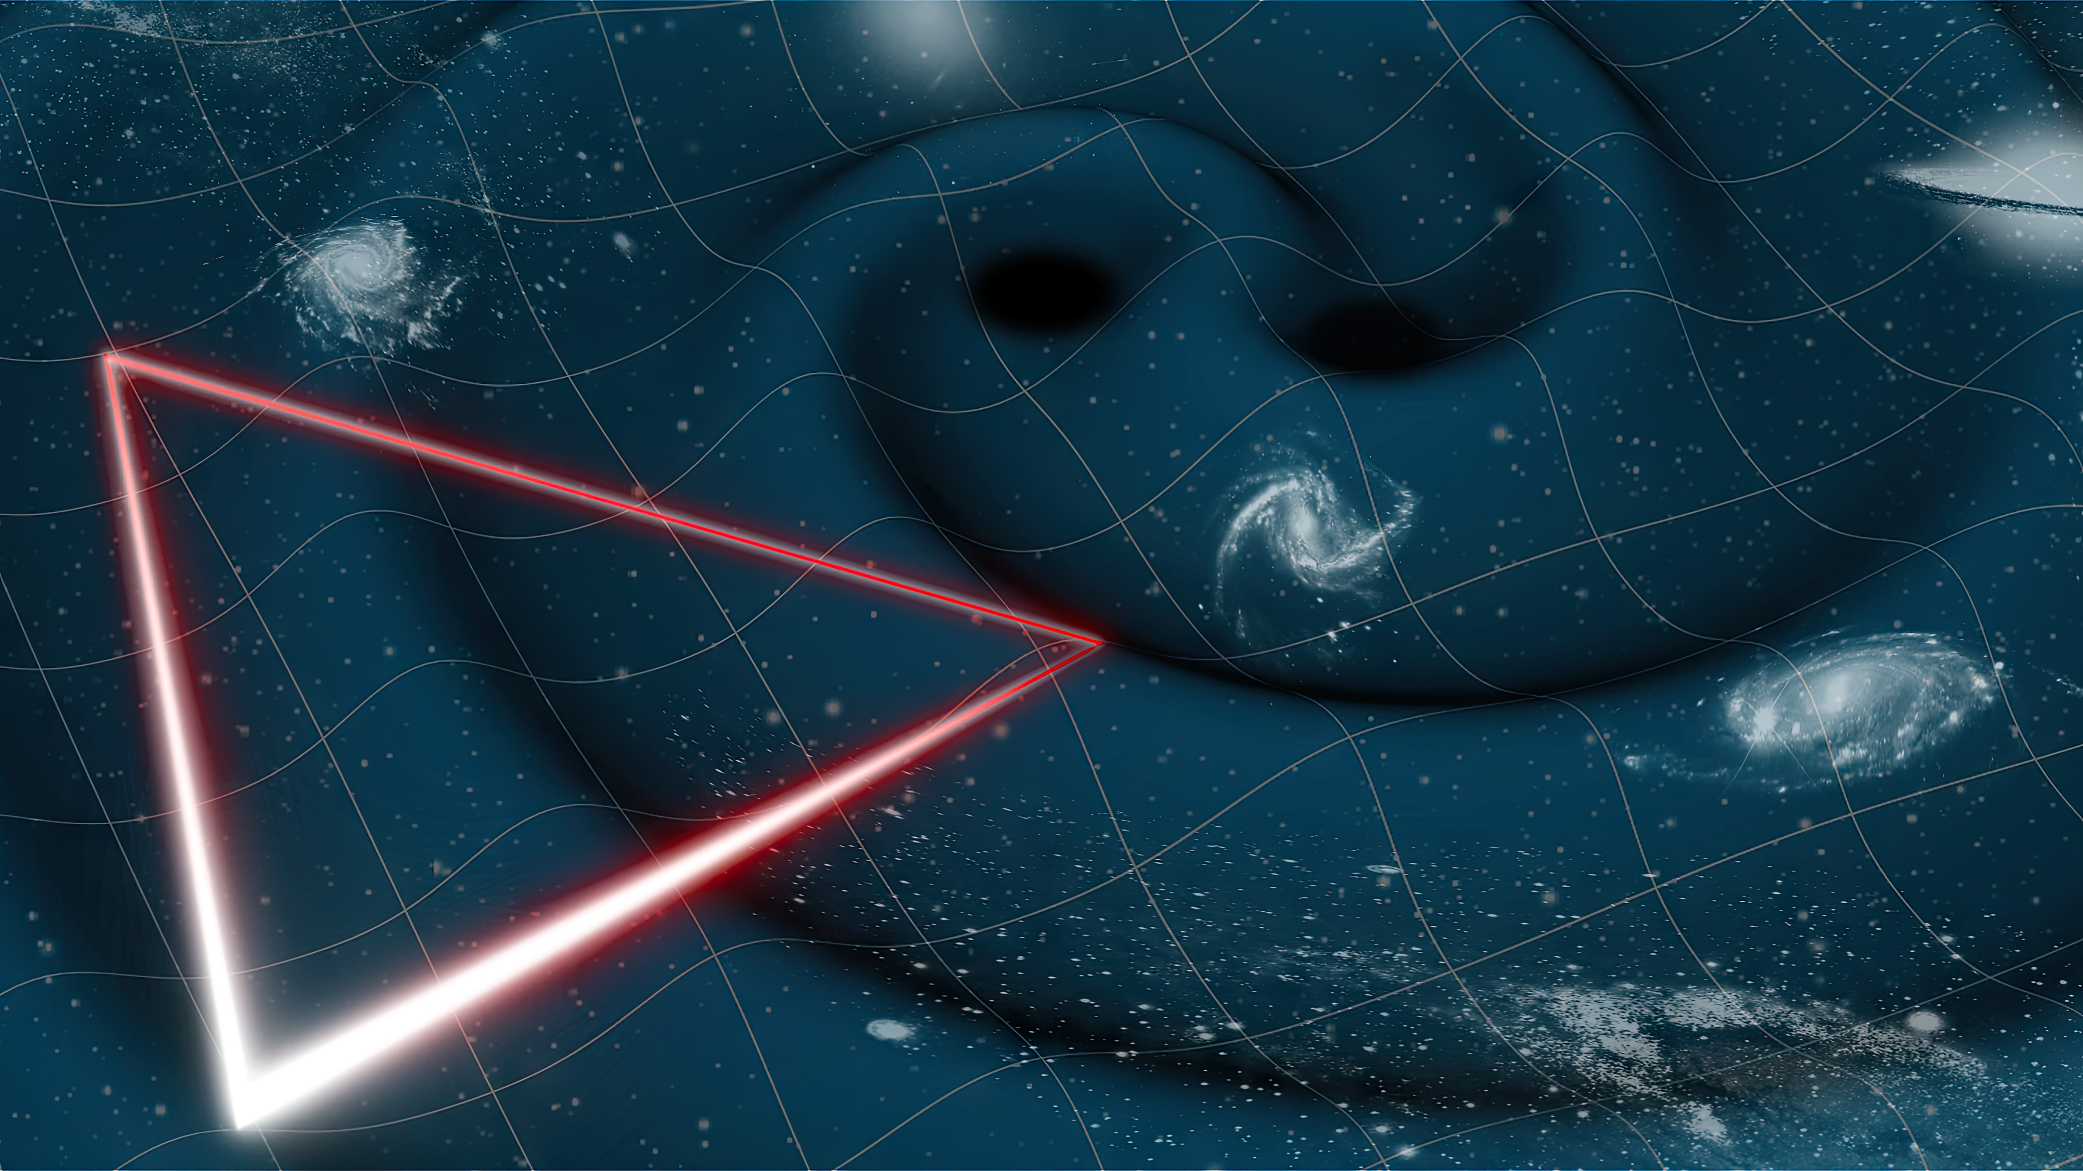
Testbed for Validating Second-Generation TDI and Clock Noise Correction for LISA
Karin Kruuse
Supervisor: Guido Müller
Notes:
Date. Change
Add event, location, student seminar intro talk

Slide 2
Outline of the Talk
LISA interferometry
About previous LISA simulators
Overview of our proposed LISA testbed
Its purpose and goals
Status of the current purely electronic testbed
Putting together an optical input
Notes:
studying the realistic clock noise pipeline

Slide 3
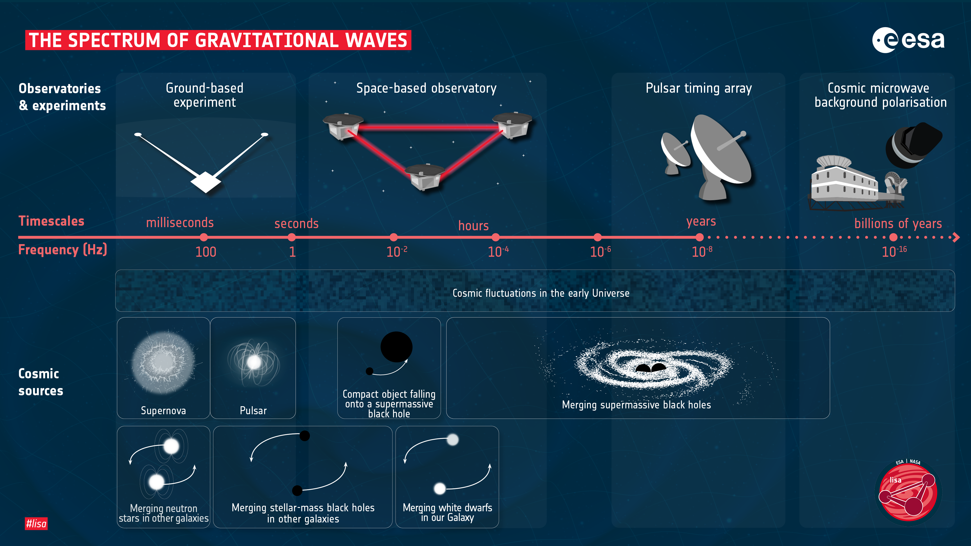

Slide 4
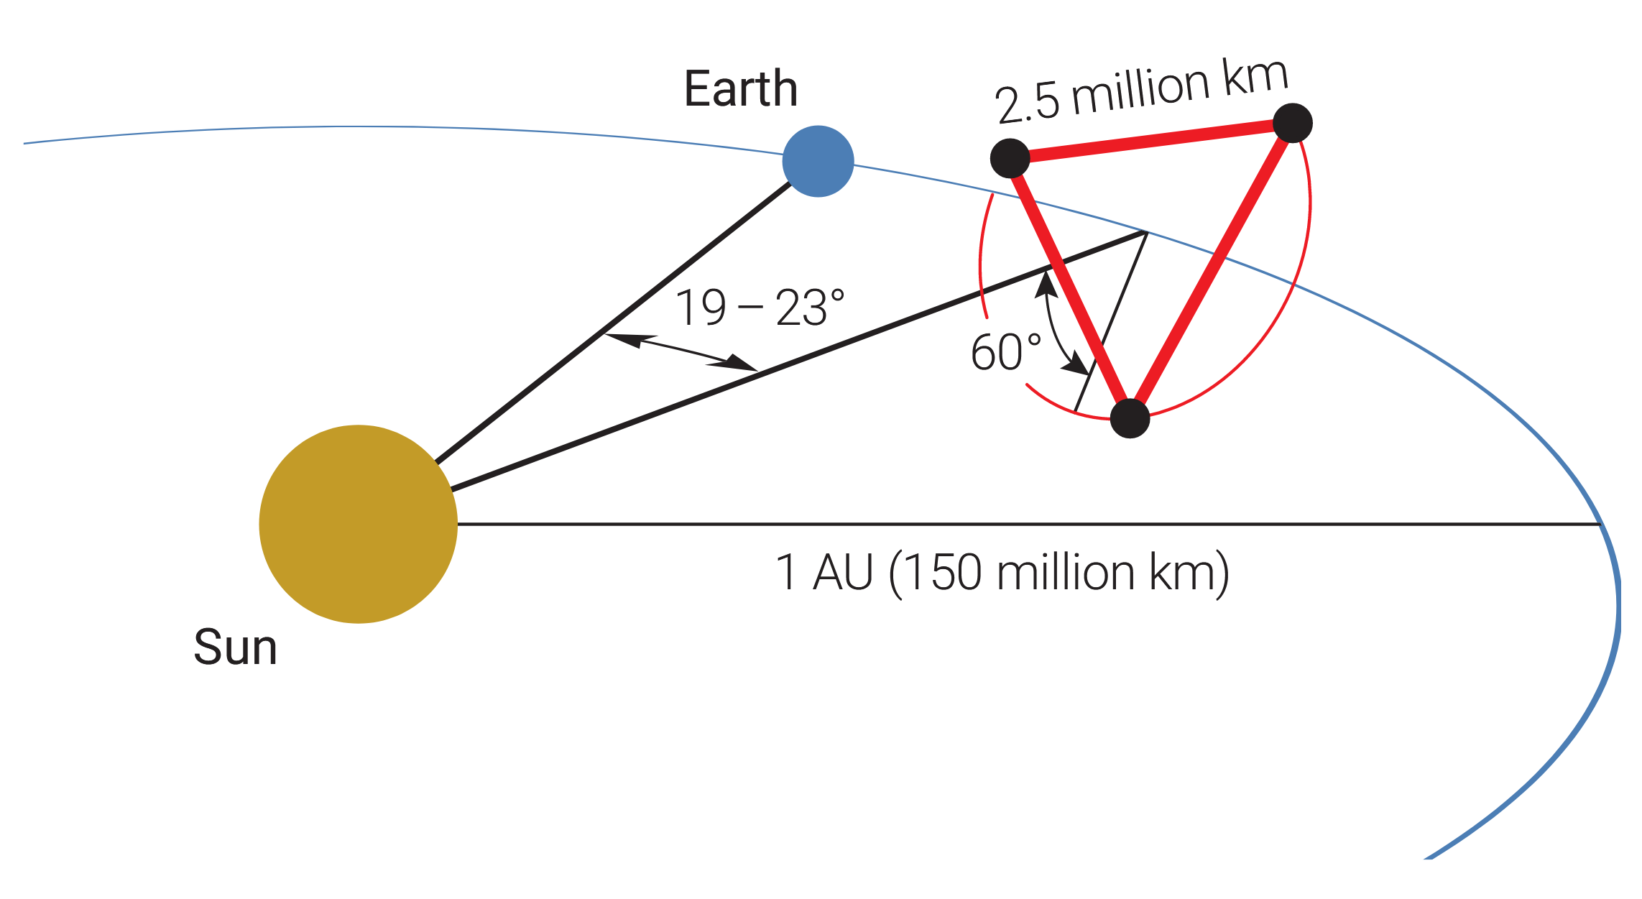
LISA
Space-based gravitational wave detector
No seismic noise and longer arm length improve sensitivity.
The arm-lengths are unequal and time-varying
which means laser noise won’t cancel out
and the laser fields experience Doppler shifts in the range from -10 to 10 MHz
Amaro-Seoane et al., 2017

Slide 5
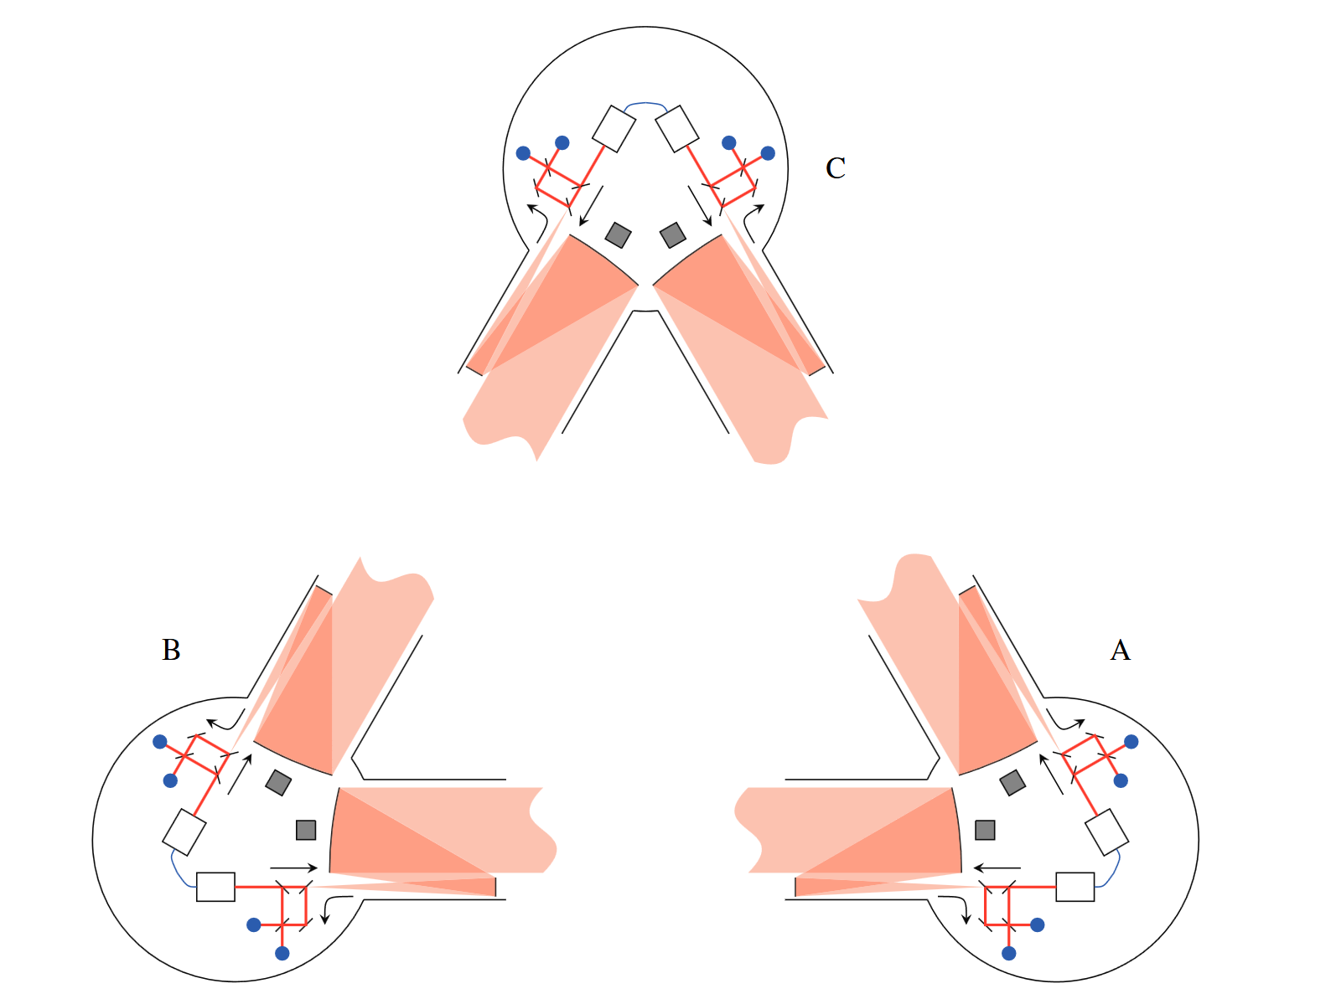
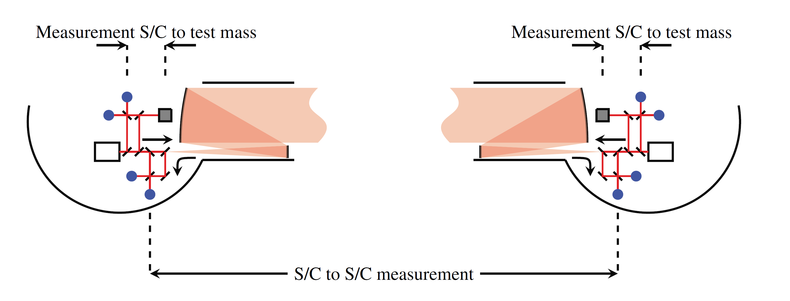
The Satellites
Three satellites surrounding six test masses in free fall
Each satellite houses two lasers, two optical benches and a phasemeter.
Each optical bench houses three interferometers.
The test mass to test mass distances are measured in three parts – this is the so-called split interferometry used in LISA.
Jennrich, 2010
Notes:
Maybe just bullet points/ or just read only if that helps with nerves

Slide 6
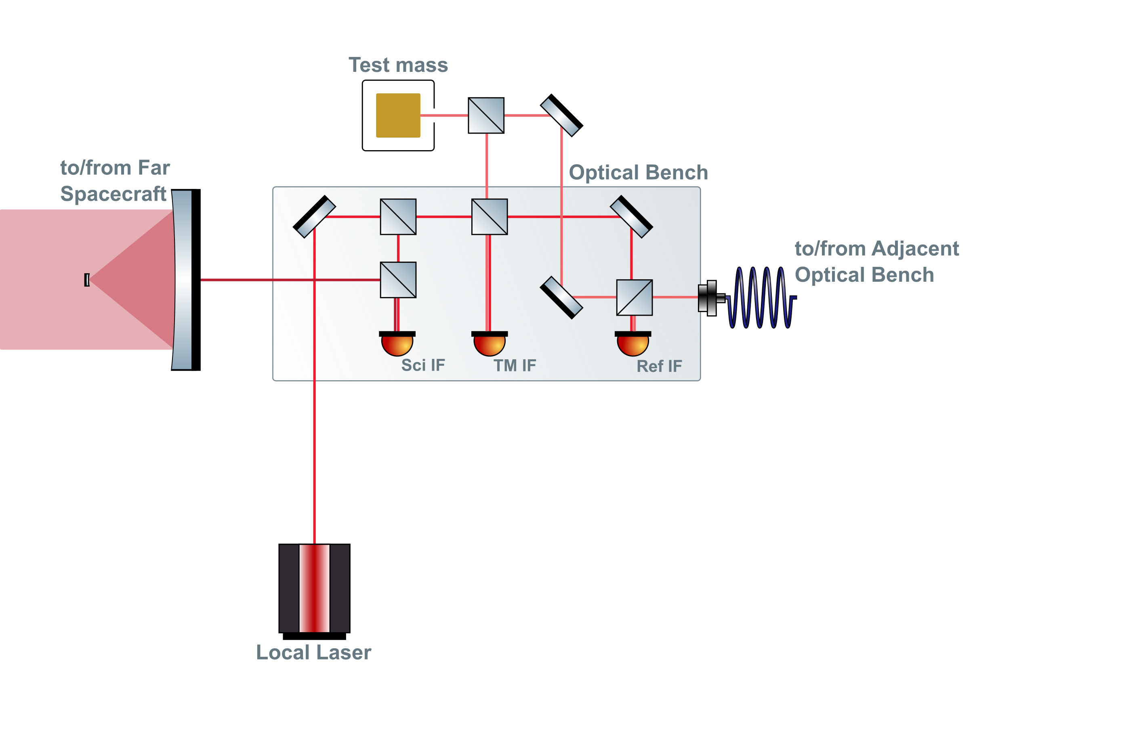
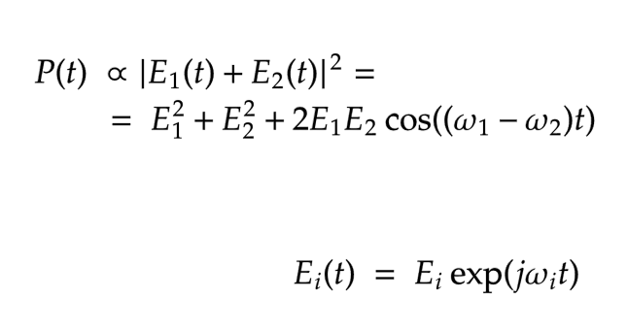
Internals of a LISA Spacecraft
LISA interferometric metrology system
heterodyne interferometry

Slide 7
Internals of a LISA Spacecraft
LISA interferometric metrology system
heterodyne interferometry
Beatnote

Slide 8
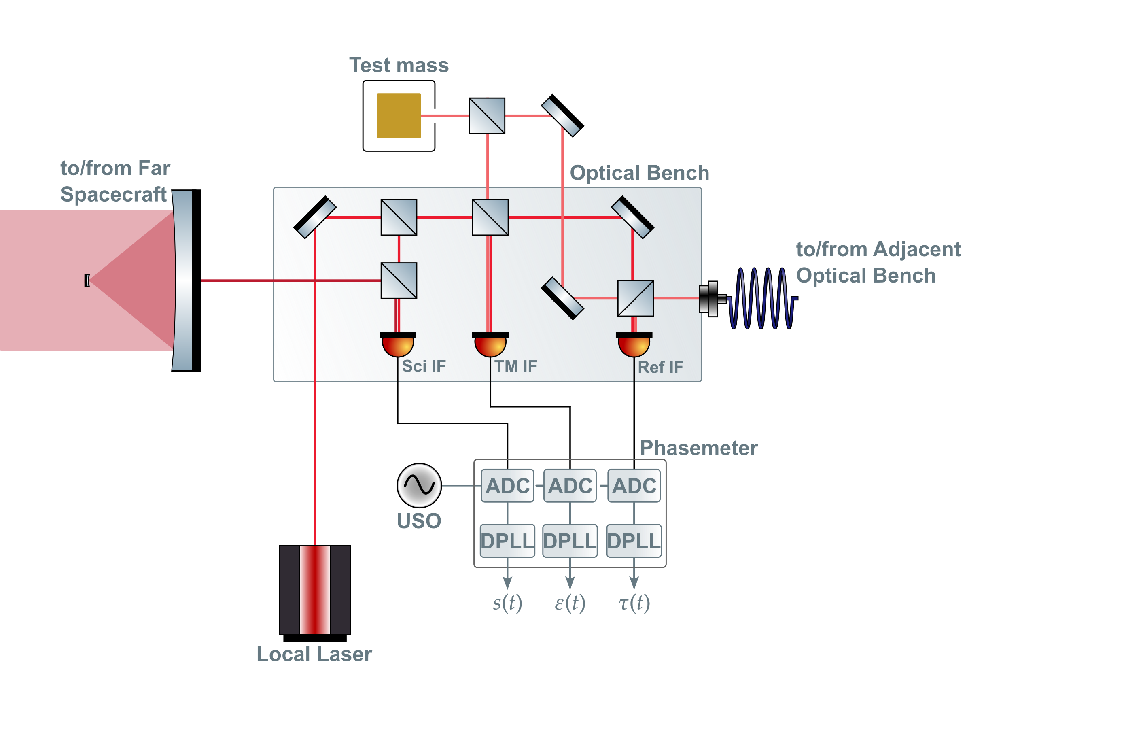
Internals of a LISA Spacecraft
USO – Ultra Stable Oscillator

Slide 9
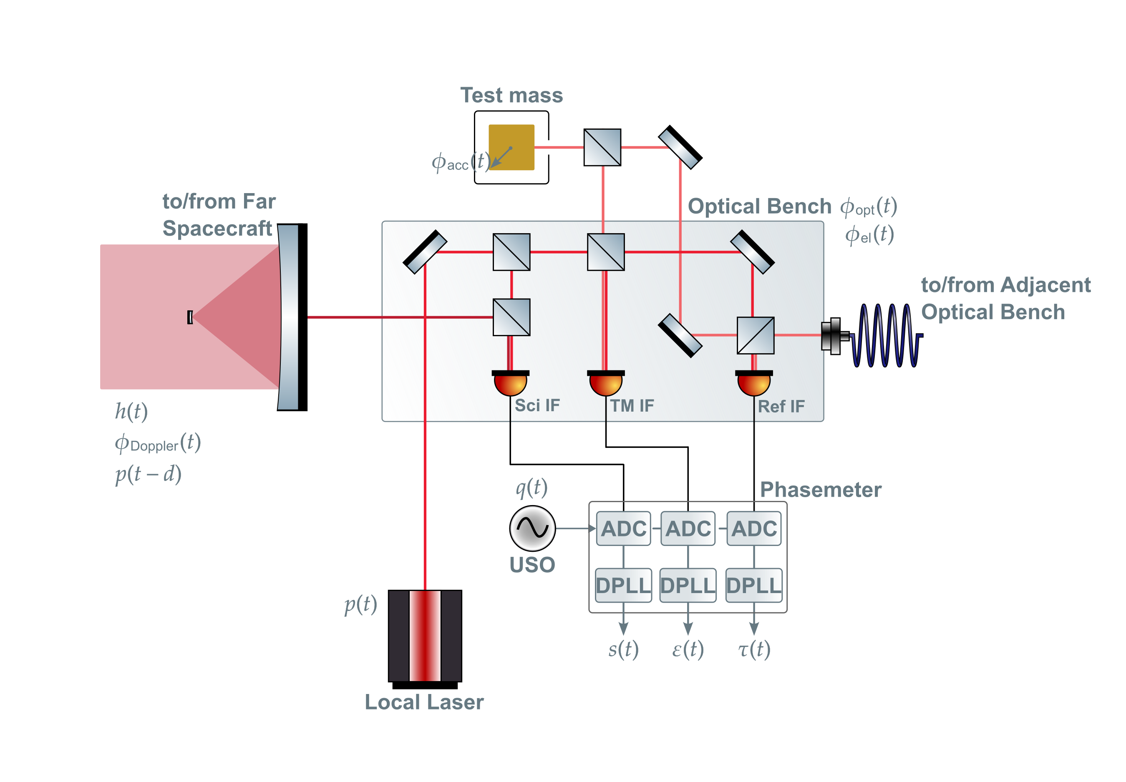
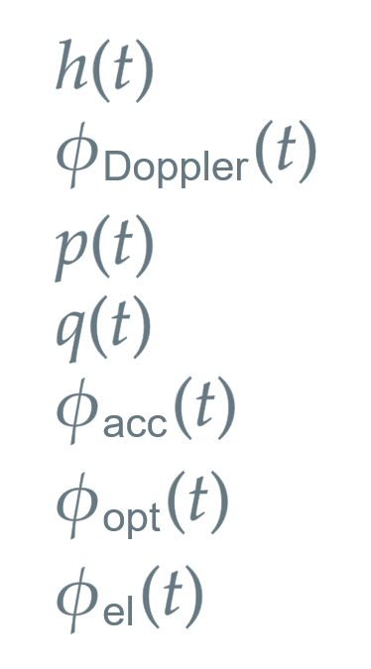
Internals of a LISA Spacecraft
GW Signal
Doppler Shift
Laser Noise
Clock Jitter
Acceleration noise
Optical Path Length Noise
Electrical Noises

Slide 10
Problem: Laser Noise
MHz beatnotes must be measured at μcycle precision.
The pre-stabilised laser noise levels coupled into the beatnotes are expected to be orders of magnitude higher.
Notes:
DELETE, maybe

Slide 11
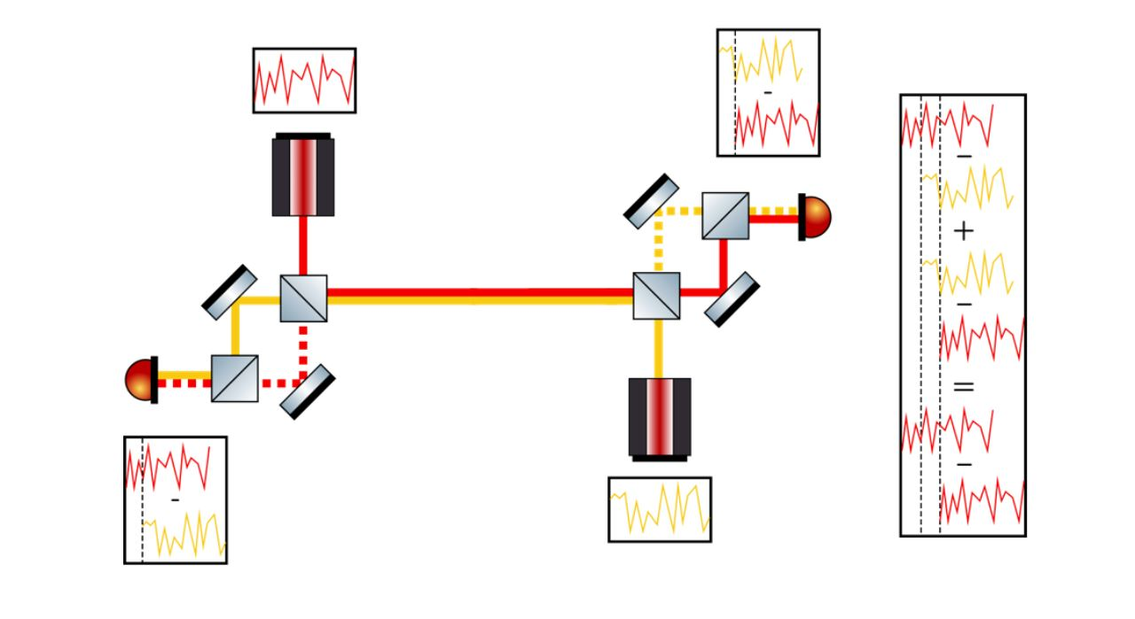
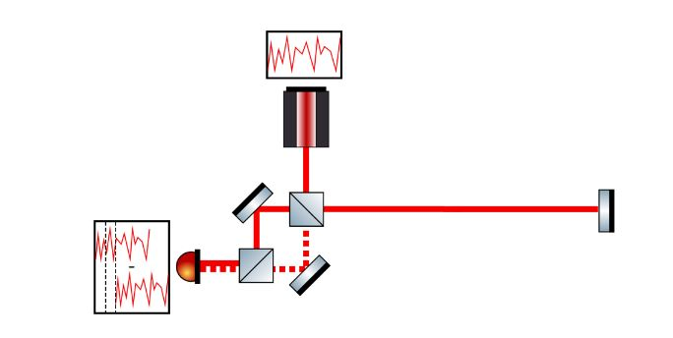
Solution: Time Delay Interferometry
Time Delay Interferometry (TDI) is a cluster of methods to construct virtual equal arms in post-processing.
Transponder signal
Virtual transponder signal
Hartwig, 2021
Notes:
Chwck the titles

Slide 12
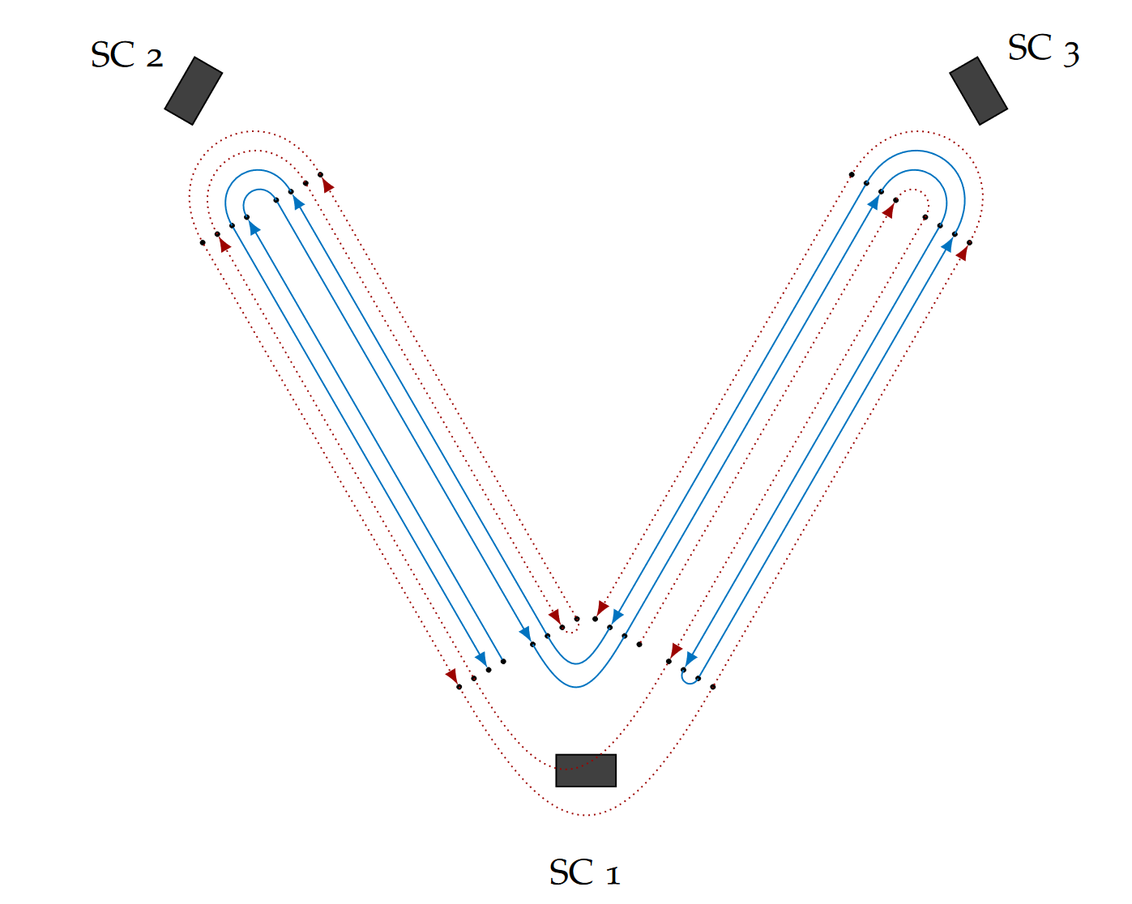
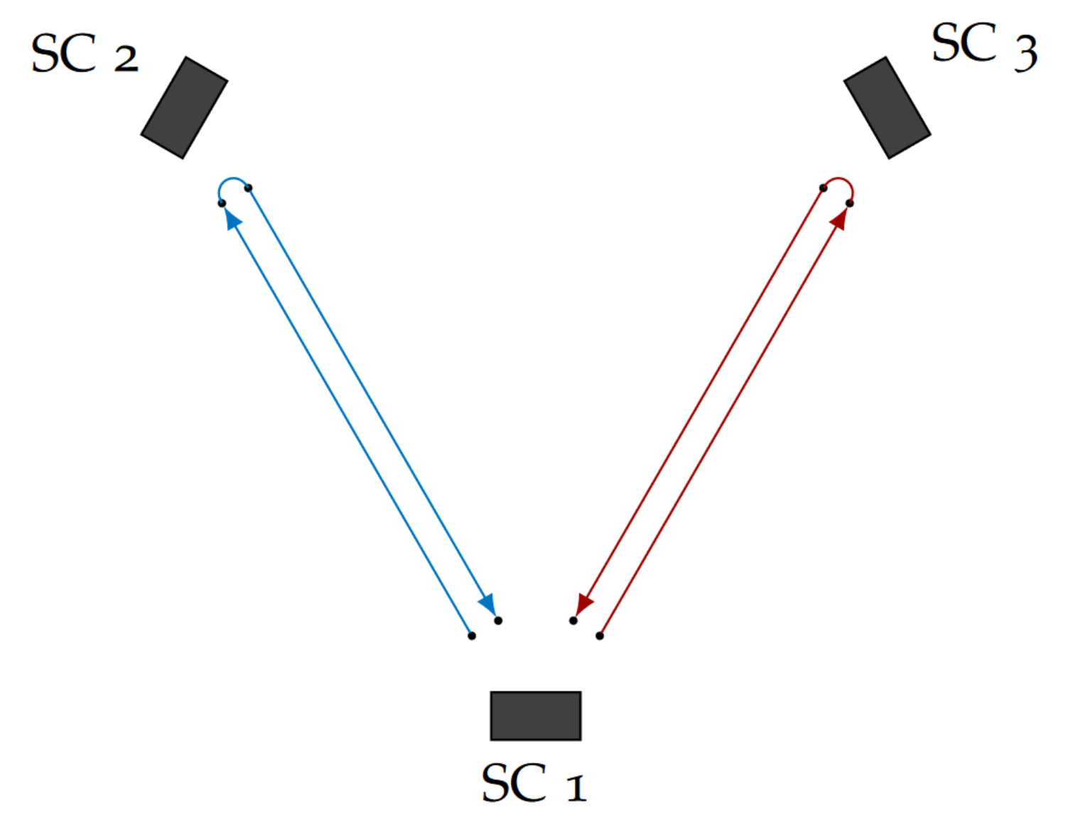
Solution: Time Delay Interferometry
Time Delay Interferometry (TDI) is a cluster of methods to construct virtual equal arms in post-processing.
0th generation TDI X combination, equal unchanging arm lengths
In practice, 2nd generation combinations should suppress noise enough to meet the requirement.
Hartwig, 2021

Slide 13
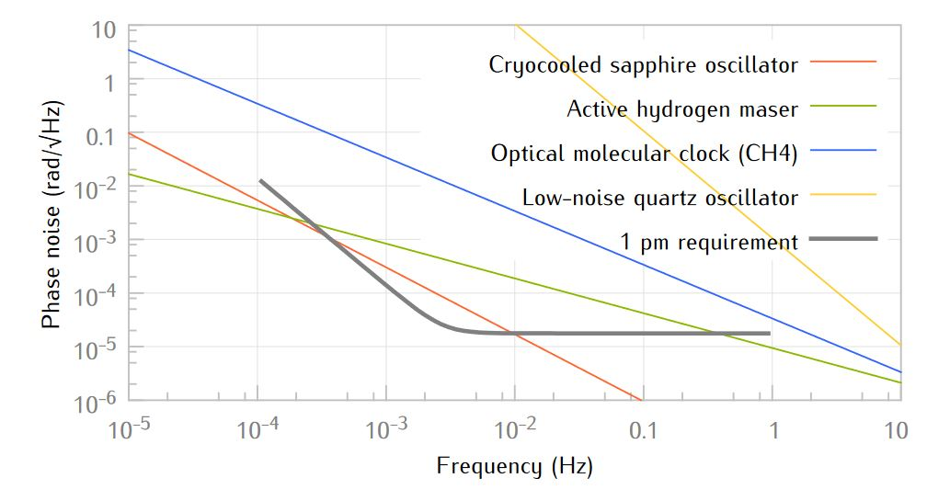
Problem: Clock Jitter
Top of the notch clock performance (2014)
Lisa metrology system-final report, 2014
Notes:
Bad quality, Sourath ghosh arm locking – current clock connest the first graph to our situation

Slide 14
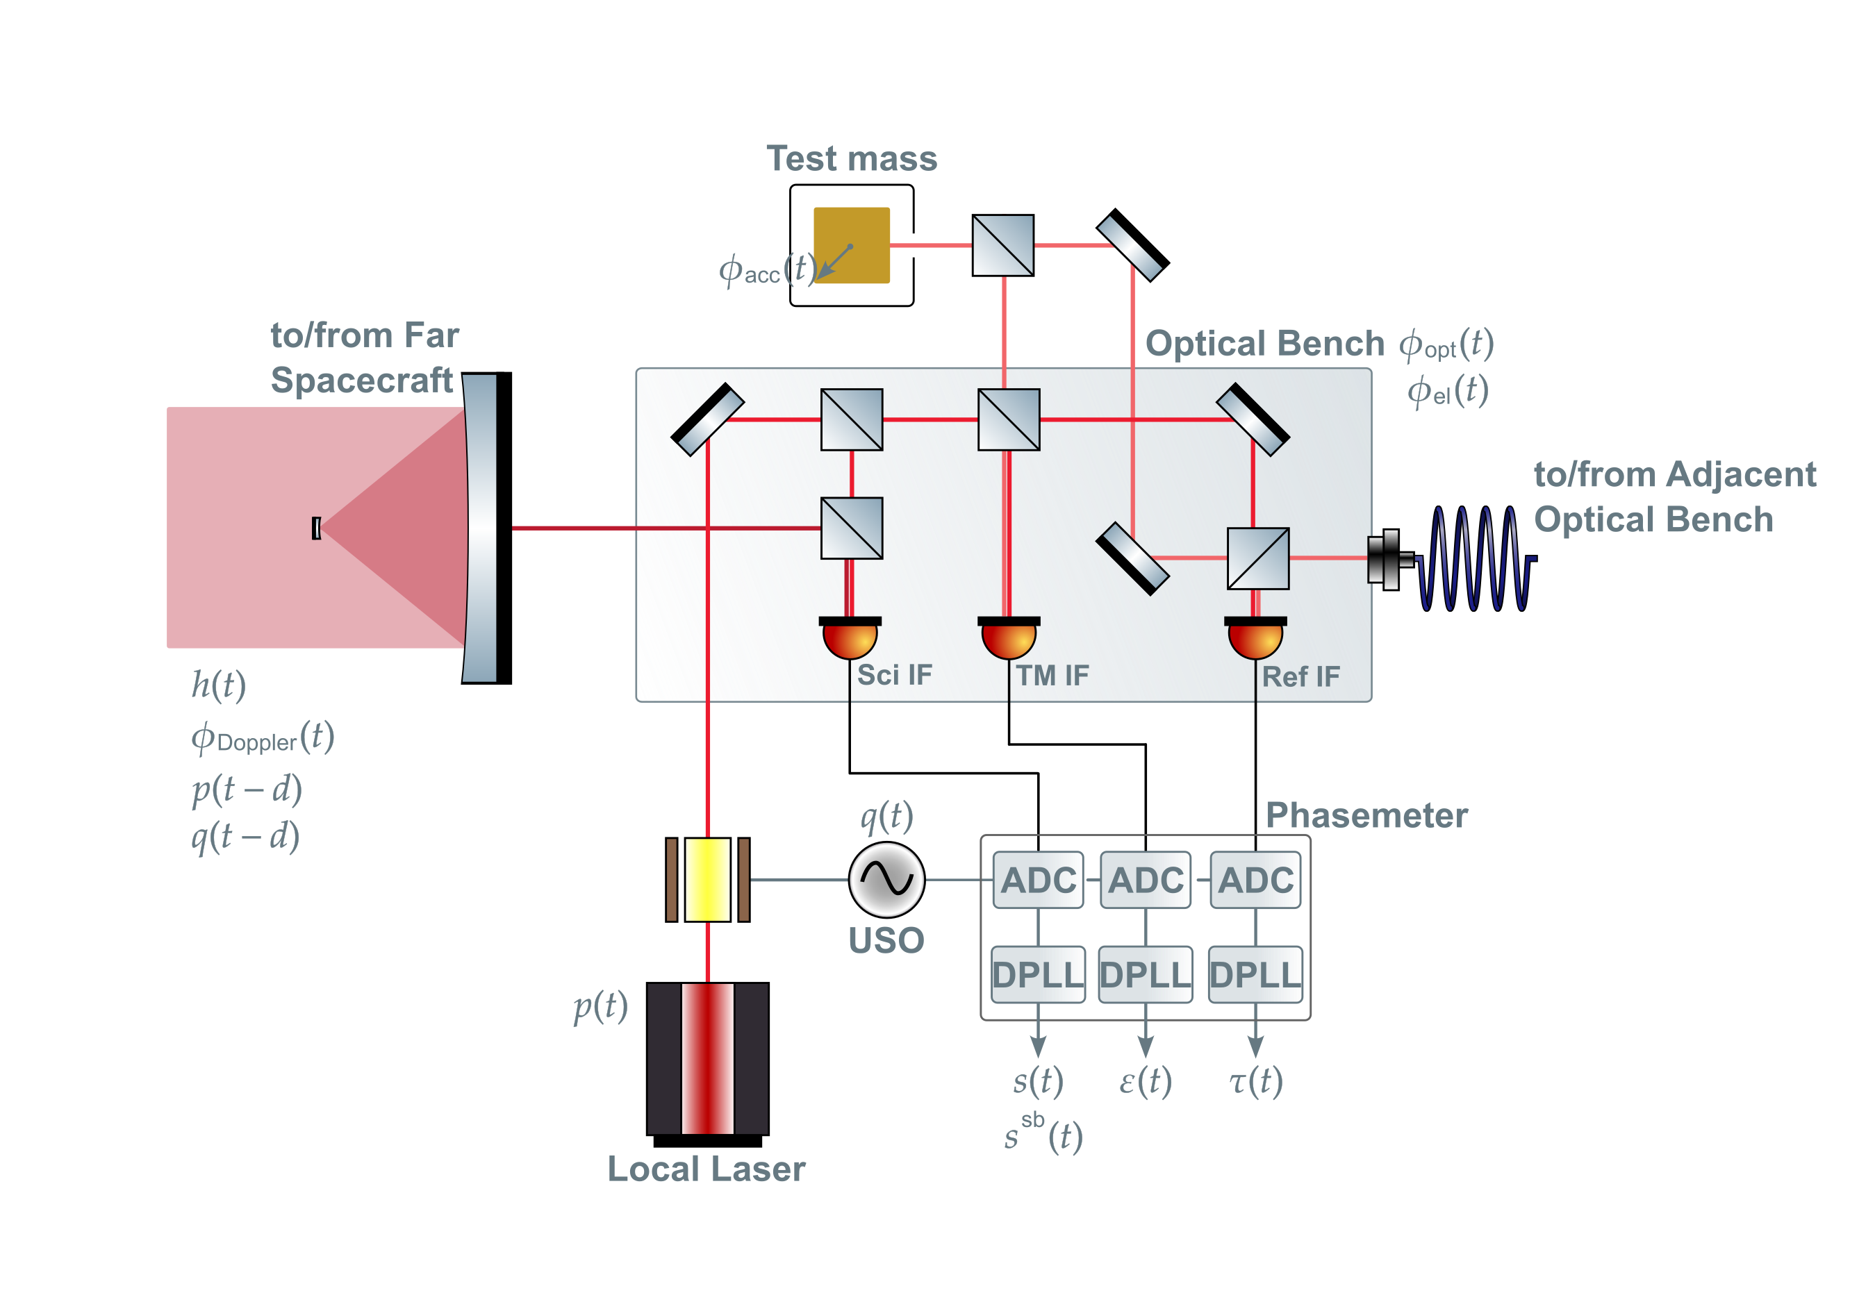
Solution: The Sidebands
Phase modulation

Slide 15
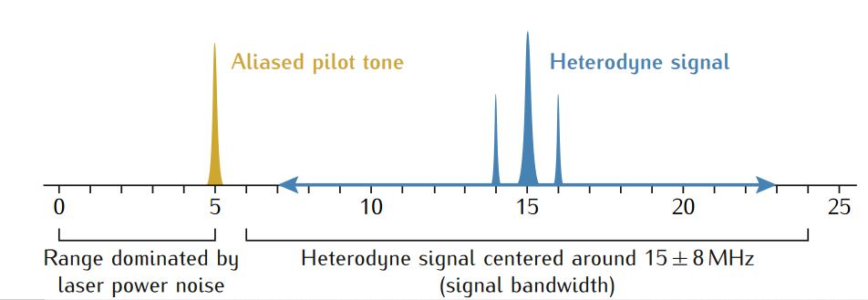
Solution: The Sidebands
Lisa metrology system-final report, 2014
Notes:
Explain the TM measurement and that this is the second/third link. Also, split interferometry

Slide 16
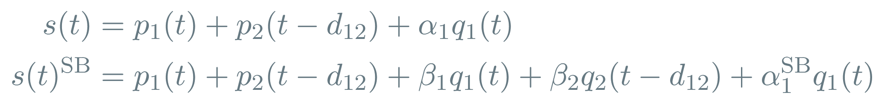
Solution: The Sidebands
After demodulation, considering laser noise and clock jitter:
Lisa metrology system-final report, 2014
Notes:
Fix t d

Slide 17
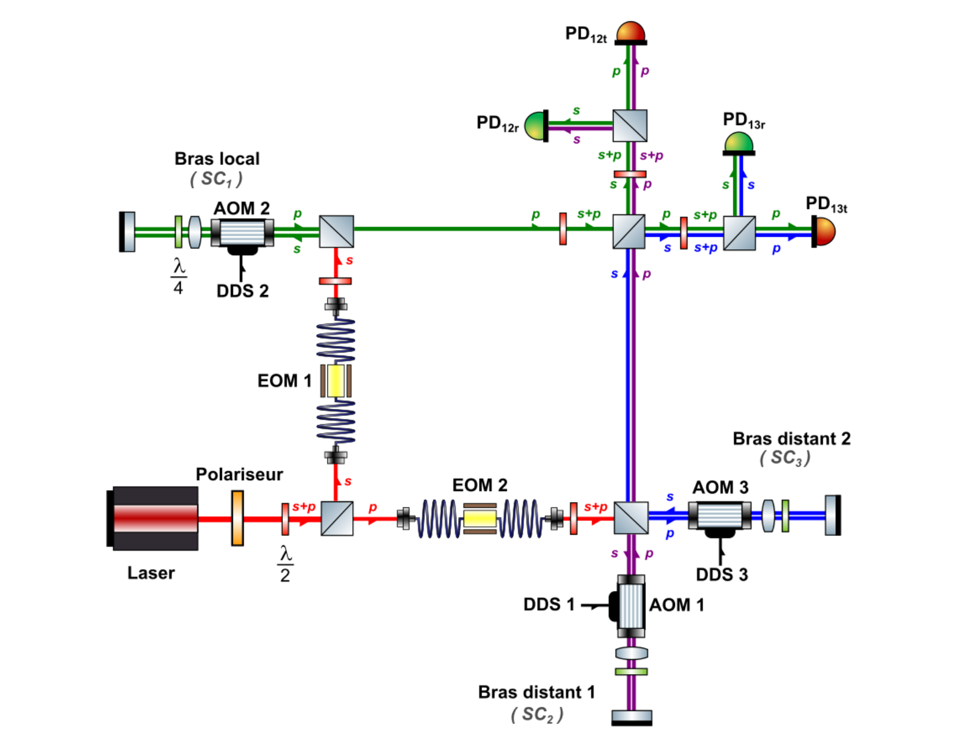
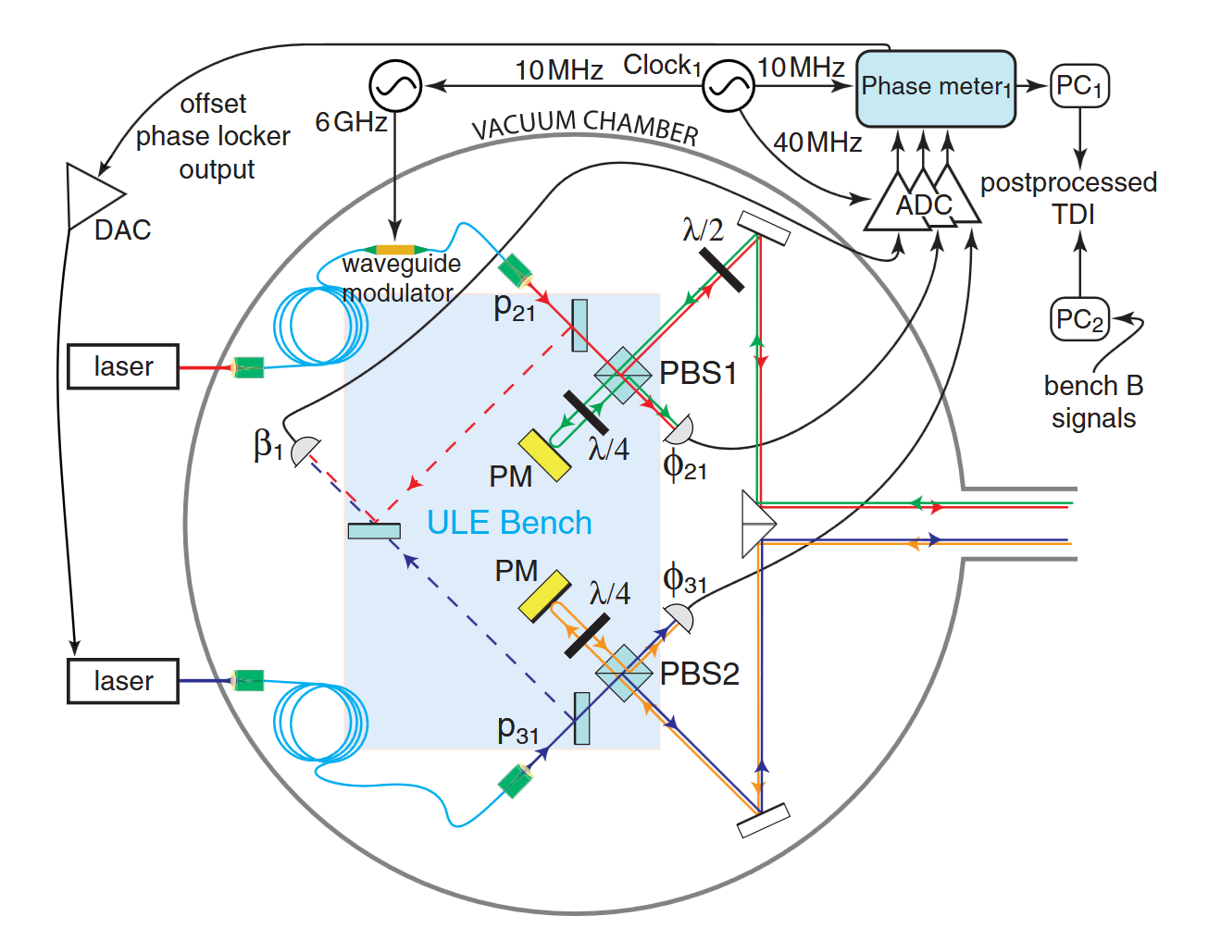
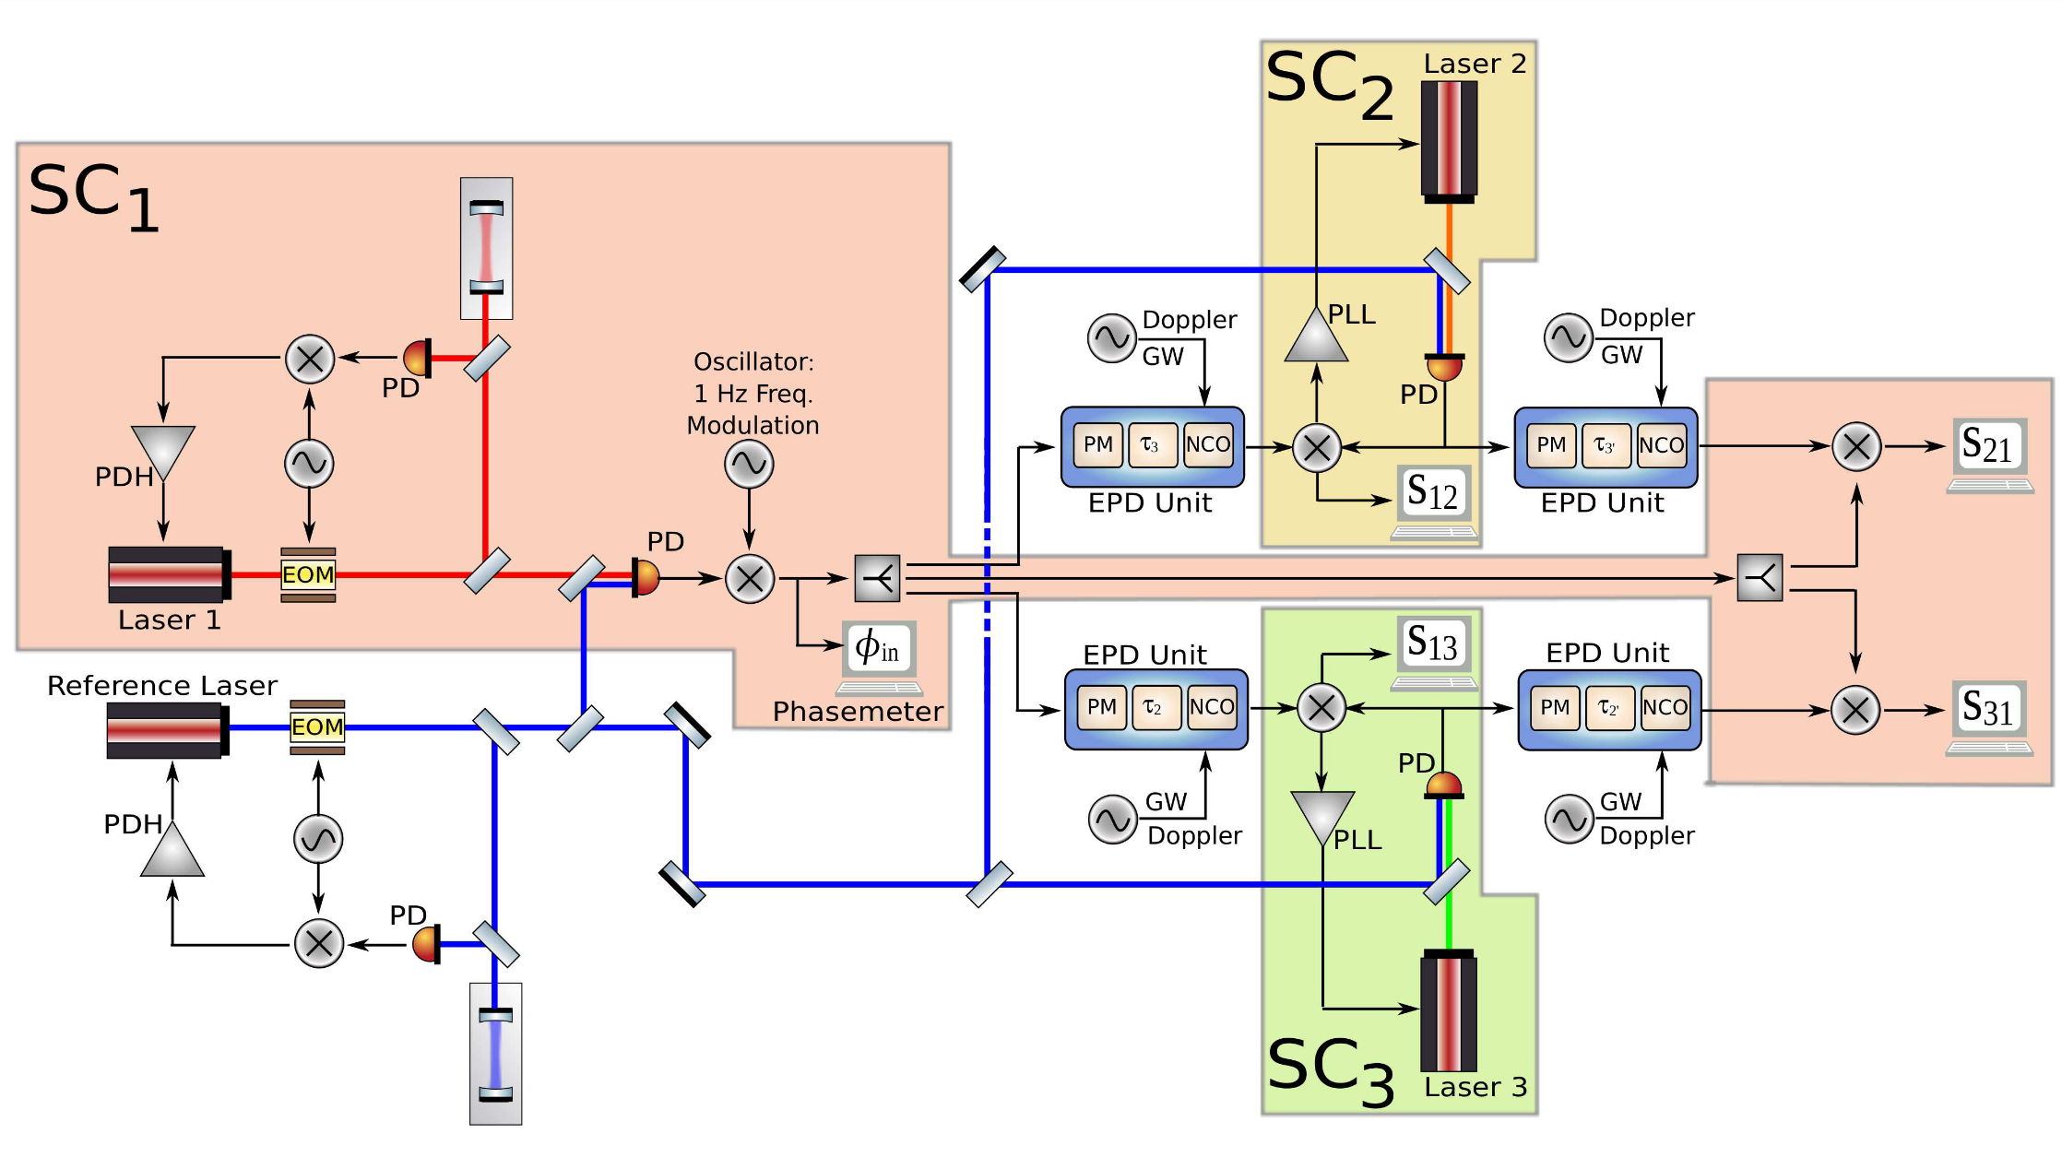
Previous Experiments
Mitryk, 2012: Laser Noise Mitigation through Time Delay Interferometry for Space-based Gravitational Wave Interferometers Using the UF Laser Interferometer
De Vine et al., 2010: Experimental Demonstration of Time-Delay Interferometry for LISA, JPL
Vidal, 2023: Validation expérimentale des performances interférométriques de LISA, Paris
Laser noise, No Clock Jitter, Realistic Delay
Laser noise, Clock jitter, No delay
Laser noise, Clock Jitter, Realistic Delay

Slide 18
Previous Experiments
Mitryk, 2012: Laser Noise Mitigation through Time Delay Interferometry for Space-based Gravitational Wave Interferometers Using the UF Laser Interferometer
De Vine et al., 2010: Experimental Demonstration of Time-Delay Interferometry for LISA, JPL
Vidal, 2023: Validation expérimentale des performances interférométriques de LISA, Paris
Laser noise, No Clock Jitter, Realistic Delay
Laser noise, Clock jitter, No delay
Laser noise, Clock Jitter, Delay
Predecessor to our testbed, limited by the technology of the time

Slide 19
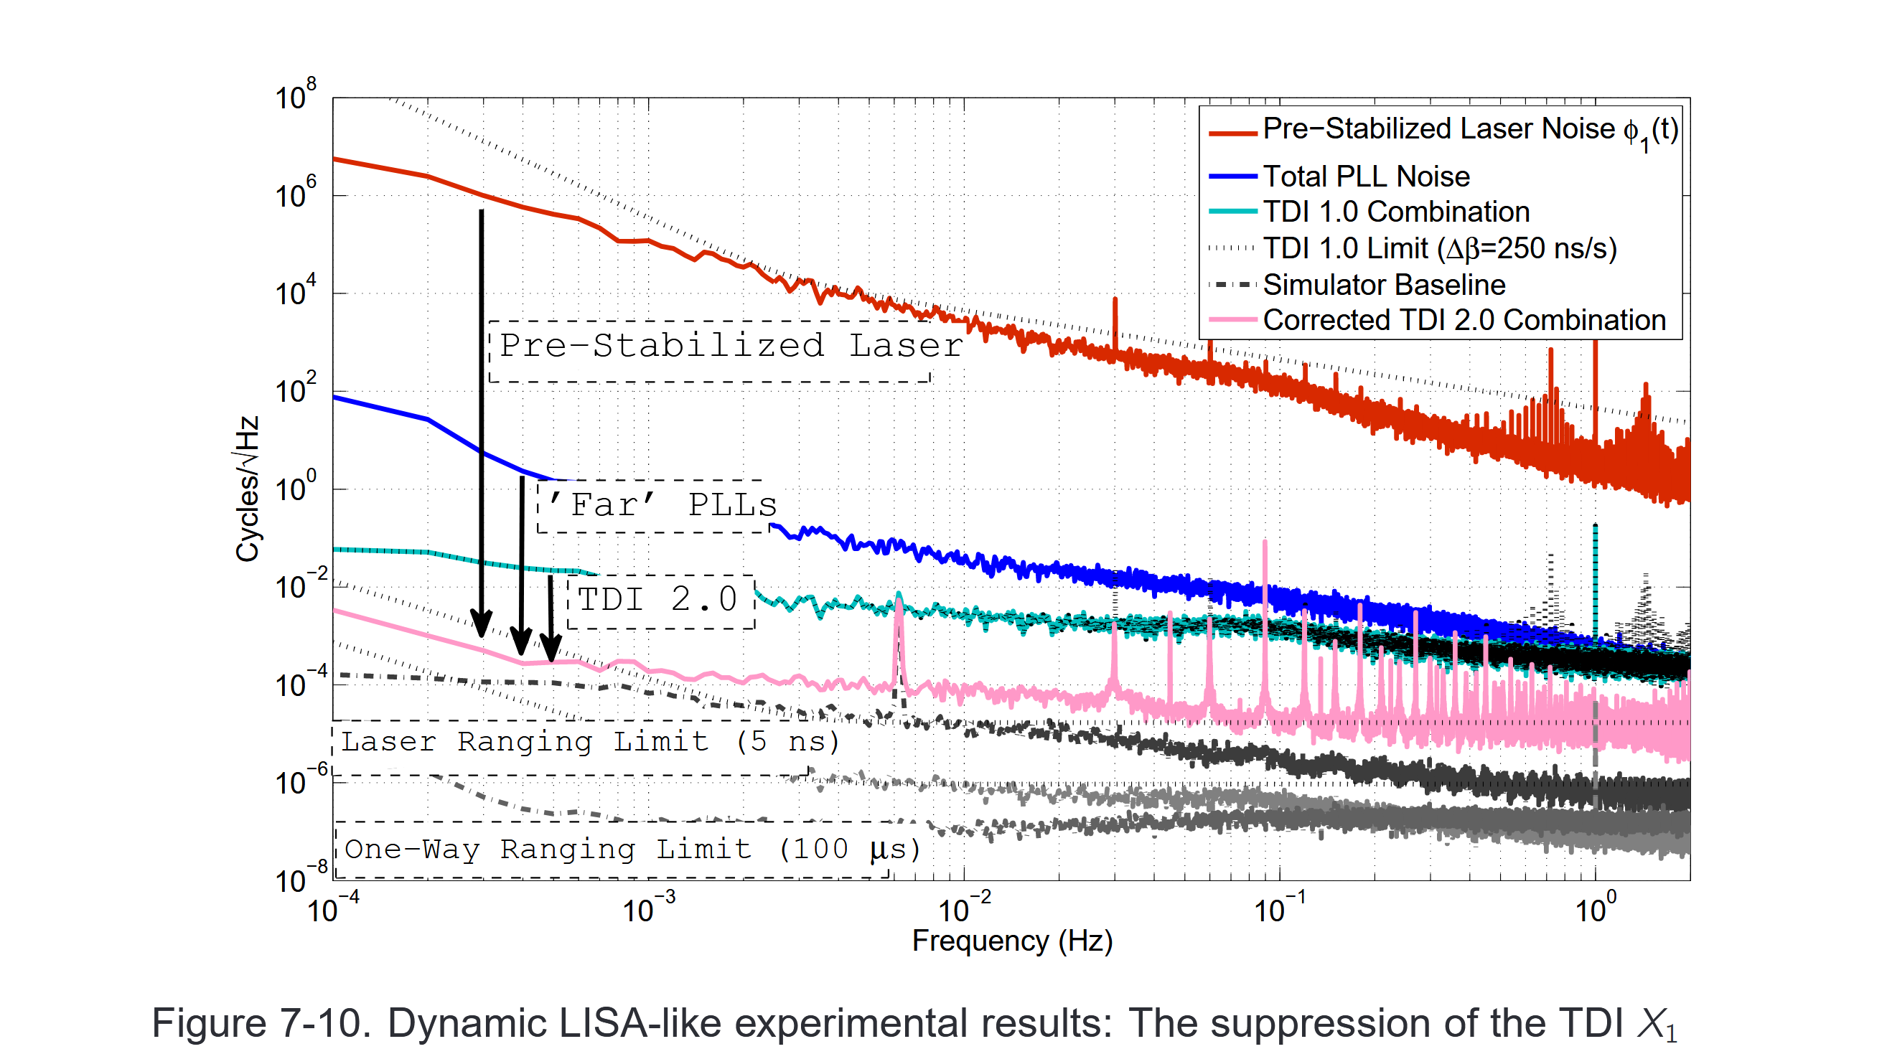
Previous Experiments
Mitryk, 2012

Slide 20
MiniLISA
MiniLISA is a hardware testbed that aims to simulate LISA’s signal chain and test whether we can recover a gravitational wave signal from a realistic, noisy system.
To start with, we want to test the combination of second generation TDI and the clock noise removal post-processing methods on experimental data.
MiniLISA could also offer a substitute to modelled noise sources included in current data analysis.
Notes:
Expand on the goals more

Slide 21
Current Status
A fully electronic implementation of the interferometry system together with a delay and gravitational wave injection has already been developed and is being tested.
Time varying delays
Doppler shifts for both the carrier and sidebands
Gravitational wave injection

Slide 22
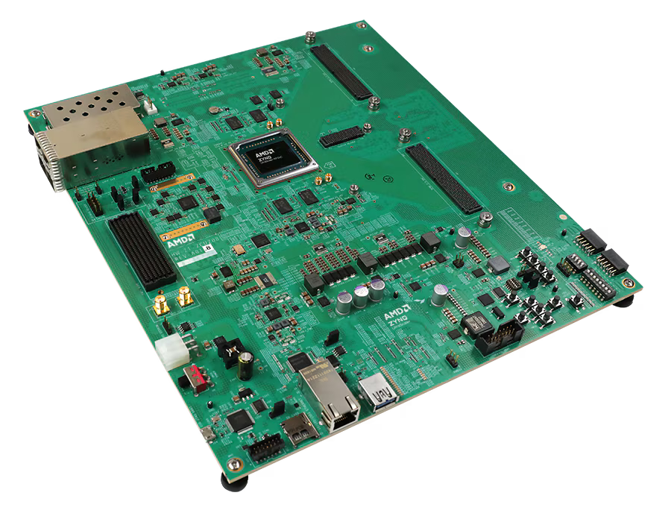
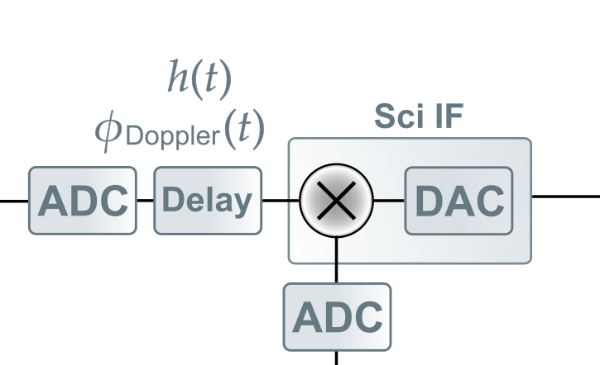
The Delay Line
The center of the experiment is the delay line.
The added varying delays, gravitational wave signals and Doppler shifts are controllable via a Python-based interface.
AMD Zynq™ UltraScale+™ RFSoC ZCU208 Evaluation Kit

Slide 23
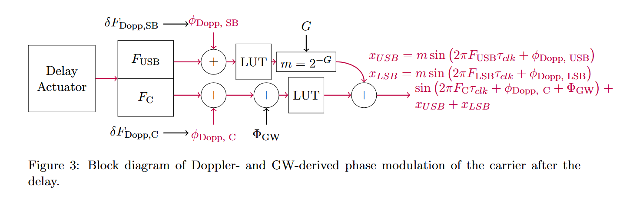
Signal Processing on the Delay Line
The evaluation board includes enough to take in two photodetector readings and output the corresponding LISA-like beatnote as an electrical signal.
Credit: Reid Ferguson

Slide 24
Delay Line Performance
Main noise source is the clock jitter, which couples into the phase measurement.
This won’t be suppressed by TDI or clock noise removal and an extra measurement is likely needed.

Slide 25
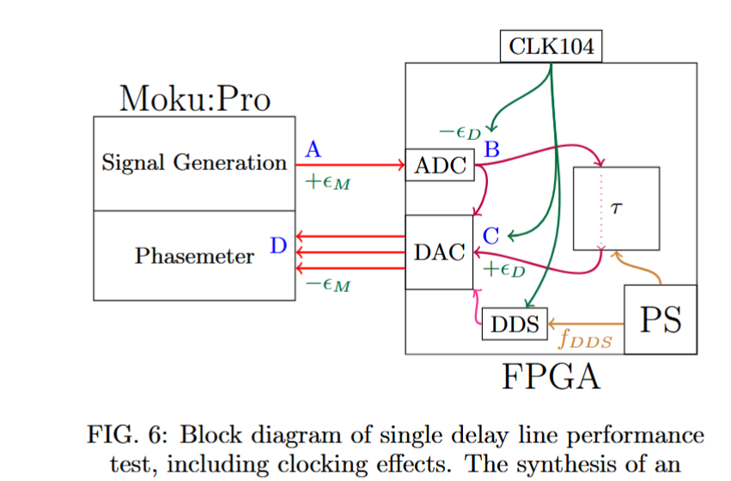
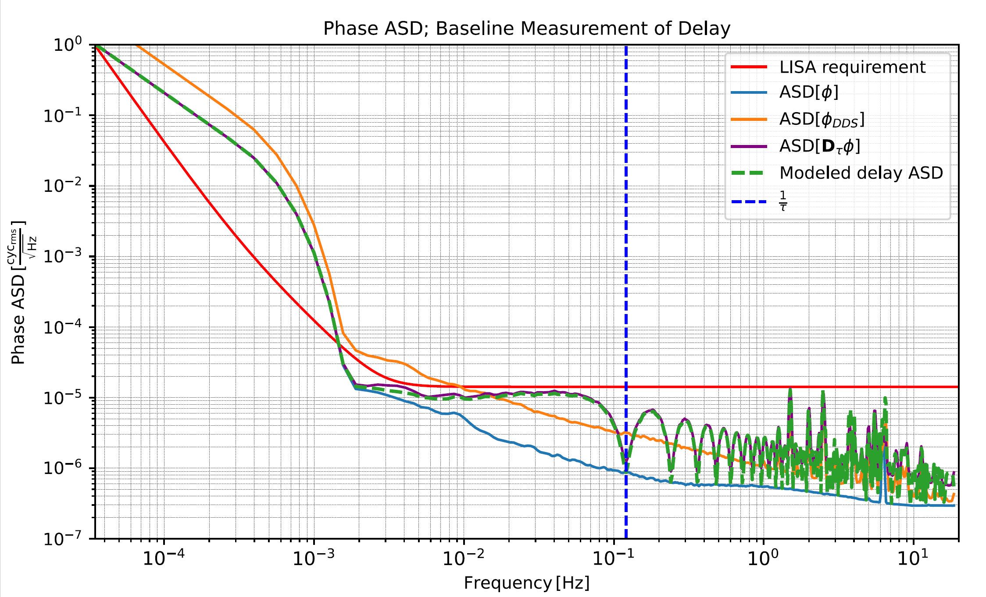
Delay Line Noise Measurement
Credit: Reid Ferguson

Slide 26
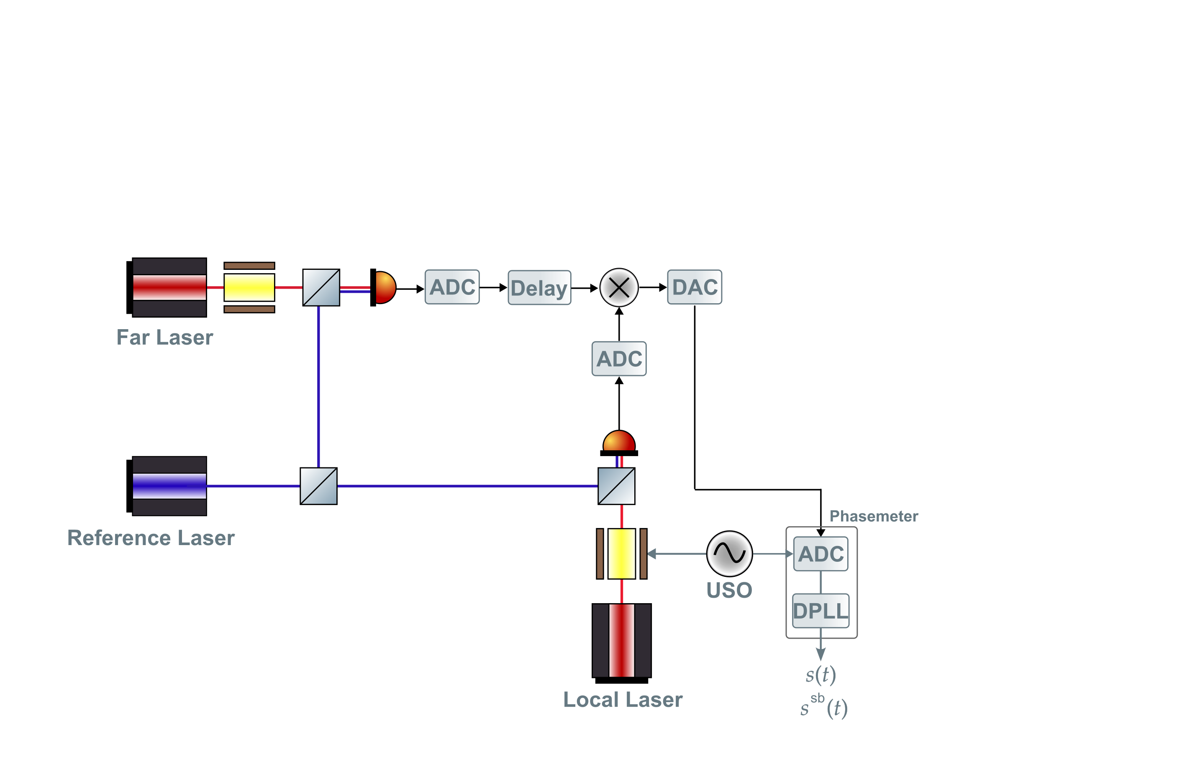
Phase Measurement with an Optical Input
Set up for generating one LISA-like science interferometer readout.
Notes:
typo

Slide 27
Phase Measurement with an Optical Input
Set up for generating one LISA-like science interferometer readout.
Sci IF
Notes:
Add the beatnotes here?

Slide 28
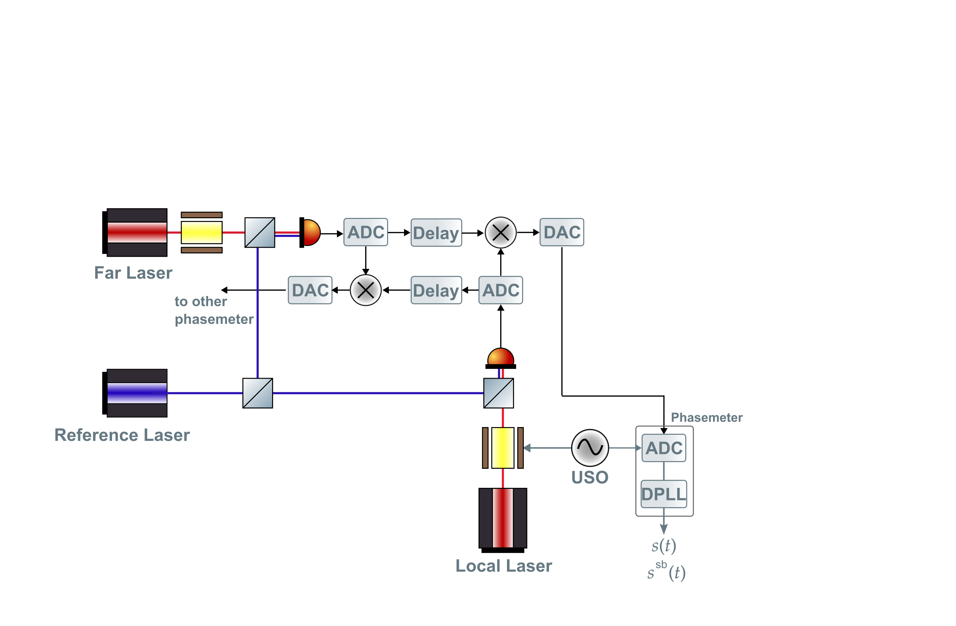
Phase Measurement with an Optical Input
Set up for generating one LISA-like arm link.
~15 MHz
~60 MHz
~10 MHz
Notes:
typo

Slide 29
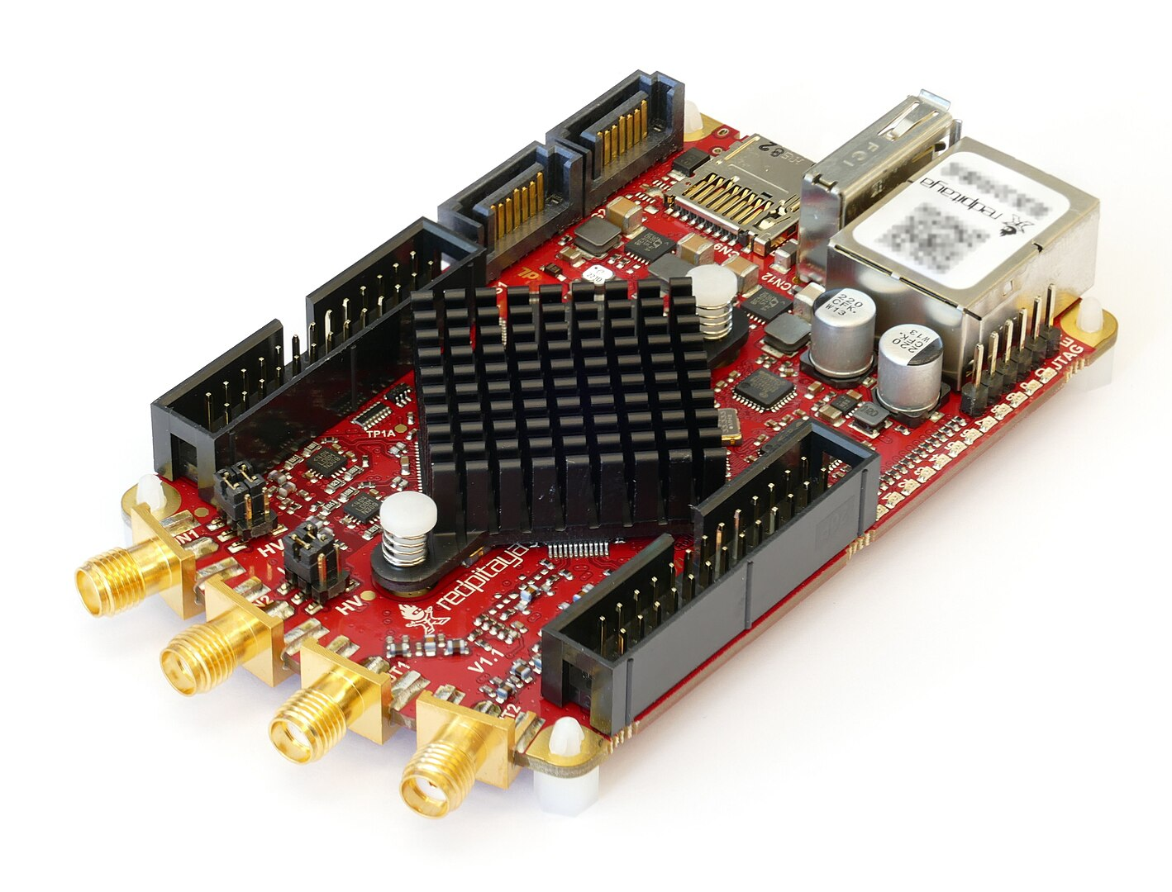
The Phasemeters
Red Pitaya running LISA gateware
Not space-qualified, but enables MHz phase readout
ADC is noisier than LISA’s frontend, but pilot tone correction helps Each board has two inputs and two outputs.
Red Pitaya

Slide 30
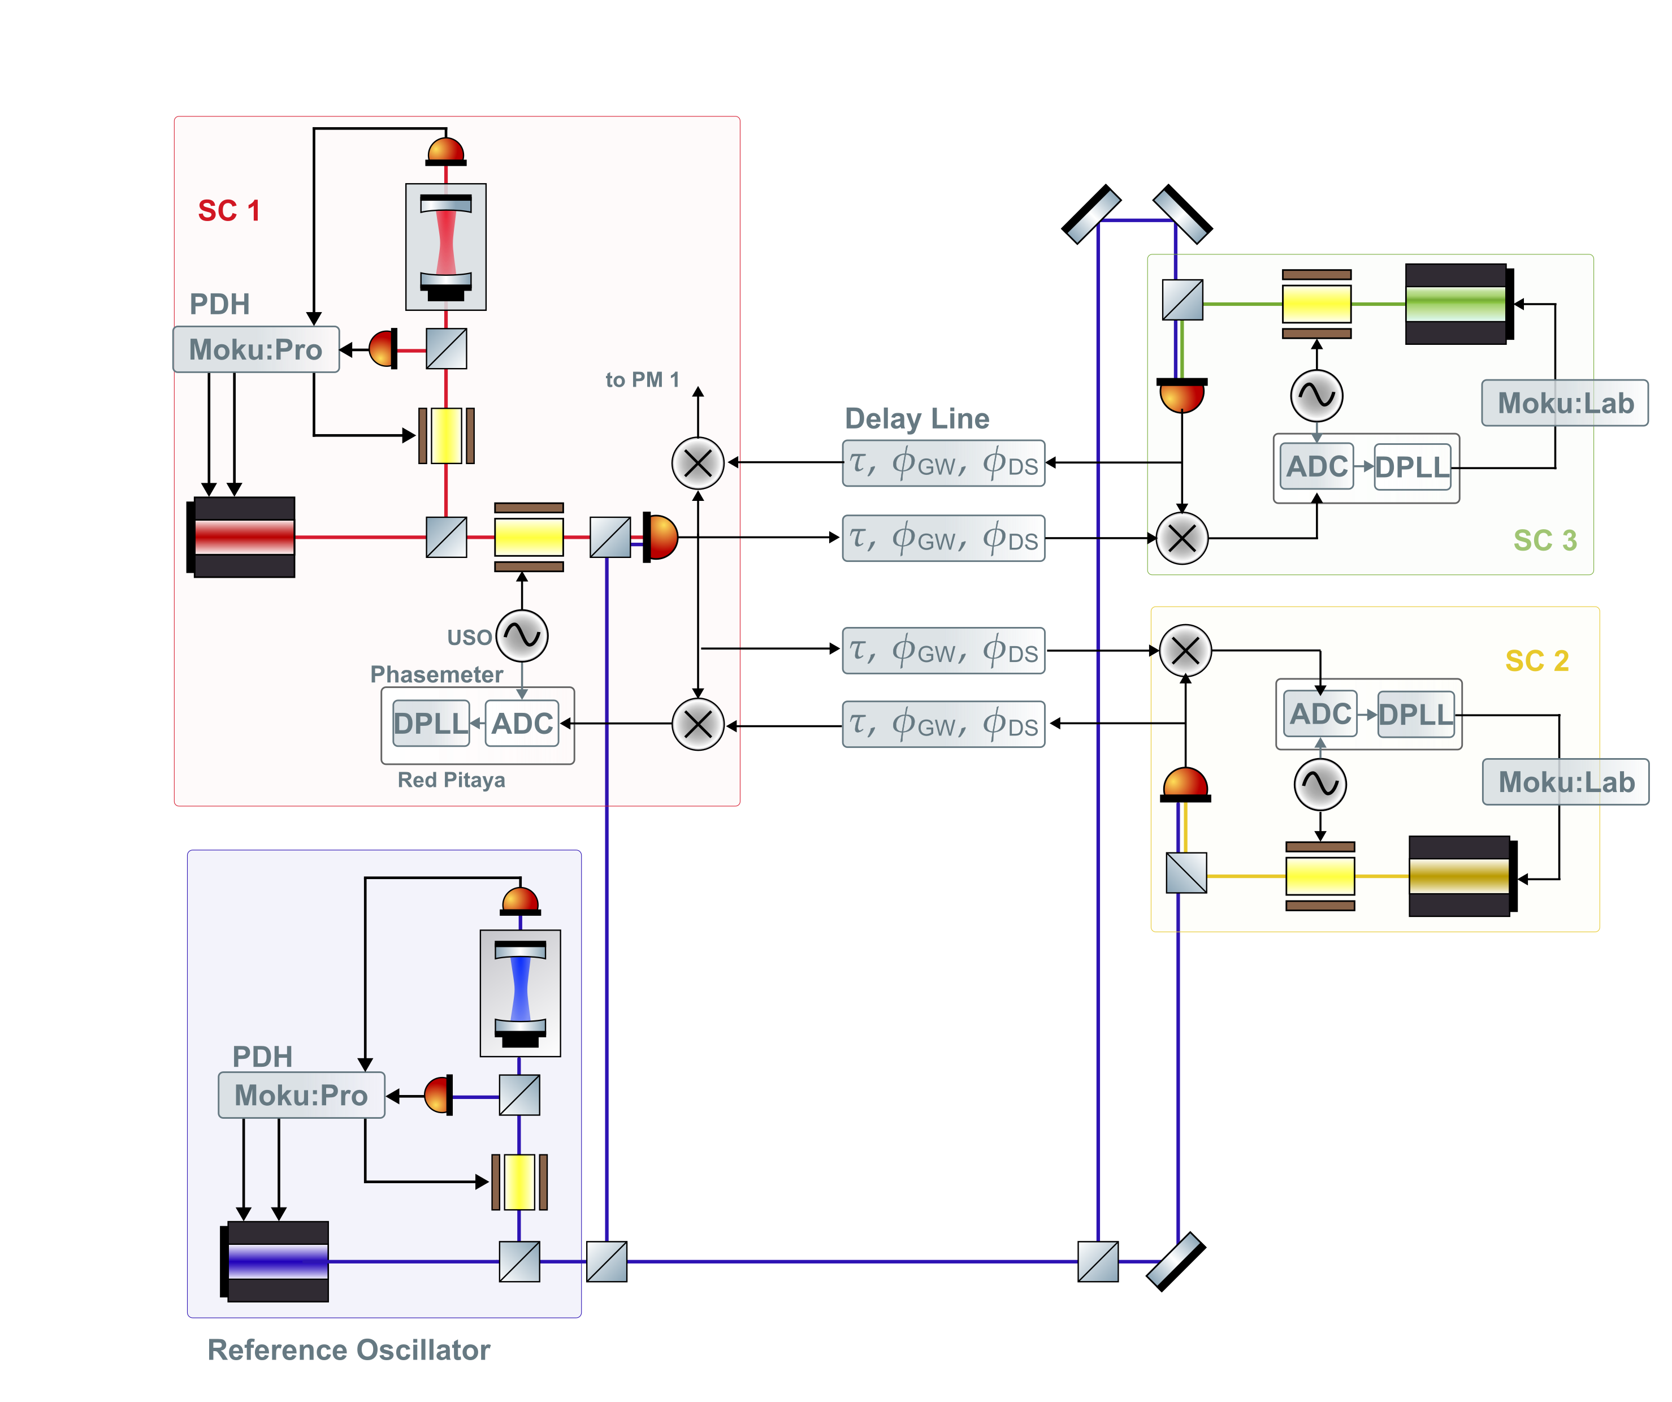
Two-arm Testbed
Notes:
Here have the reference

Slide 31
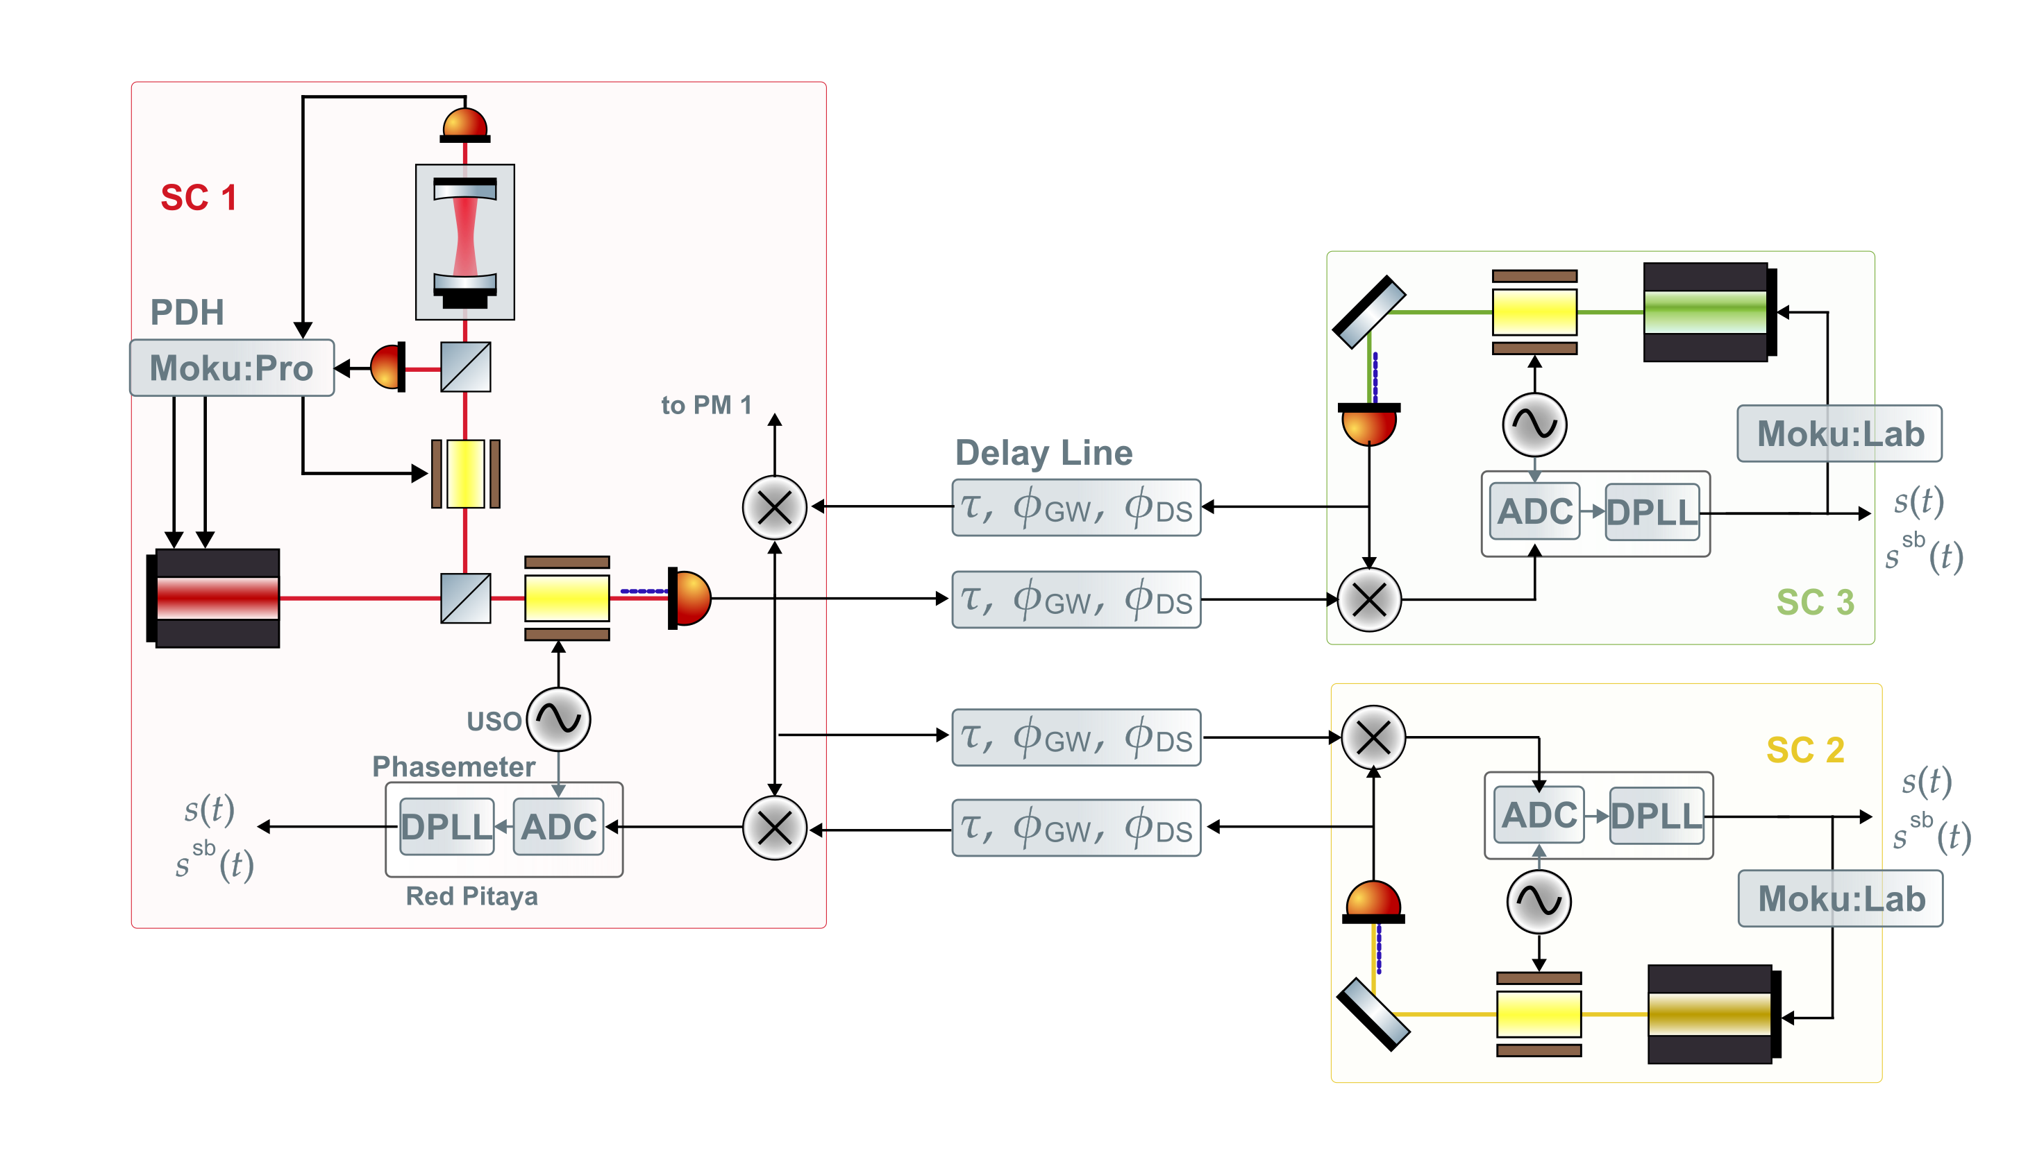
Two-arm Testbed

Slide 32
Possible Additions
More true-to-LISA clock noise transfer
Needs some more studying
Third arm link
Needs frequency planning
Test mass acceleration noise
Notes:
Firstly, the actual clock transfer system is a bit more complicated than just USO – phase modulation – read out on other SC.

Slide 33
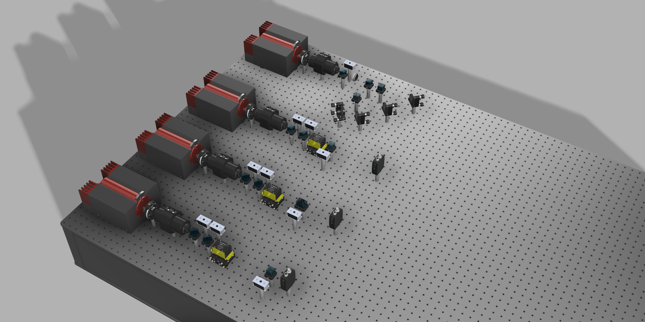
Preliminary Optical Layout
Notes:
Mention that ist not balanced deteciotn.

Slide 34
Thank you for listening!

Slide 35
Assumptions
Test mass to spacecraft distance measurement is perfect
No optical bench jittering
Adjacent/local lasers are perfectly locked
No backlink noise
Notes:
Is this necessary, is so, focus,

Slide 36
Two-arm Testbed – Technical Noise Sources

Slide 37
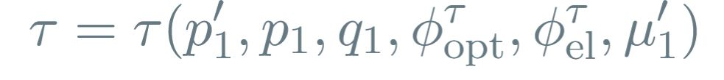
Internals of a LISA Spacecraft

Slide 38
Two-arm Testbed

Slide 39
Experimental Milestones
Laser Characterization
Measure free-running laser phase noise PSD
Lock two lasers to optical cavities
Measure cavity-locked laser noise — aim for LISA-level performance
Arm Setup
Test transponder signal to verify baseline delay chain behavior
Create first arm link
Create second arm link for full TDI X
TDI Processing
Calculate TDI combinations and clock-noise corrected PSDs
Compare results to expected suppression factors
Notes:
This one is weirdly technical

Slide 40
Frequency Planning
The beatnotes must be at predefined frequencies
The phasemeter is designed to be sensitive in the range from 5 to 25 MHz
At lower frequencies laser noise is determined to be too high.
At higher frequencies, the photodetector signals get noisier.
Doppler shifts have to be accounted for
Beatnote crossings should be avoided

Slide 41
Internals of a LISA Spacecraft

Slide 42
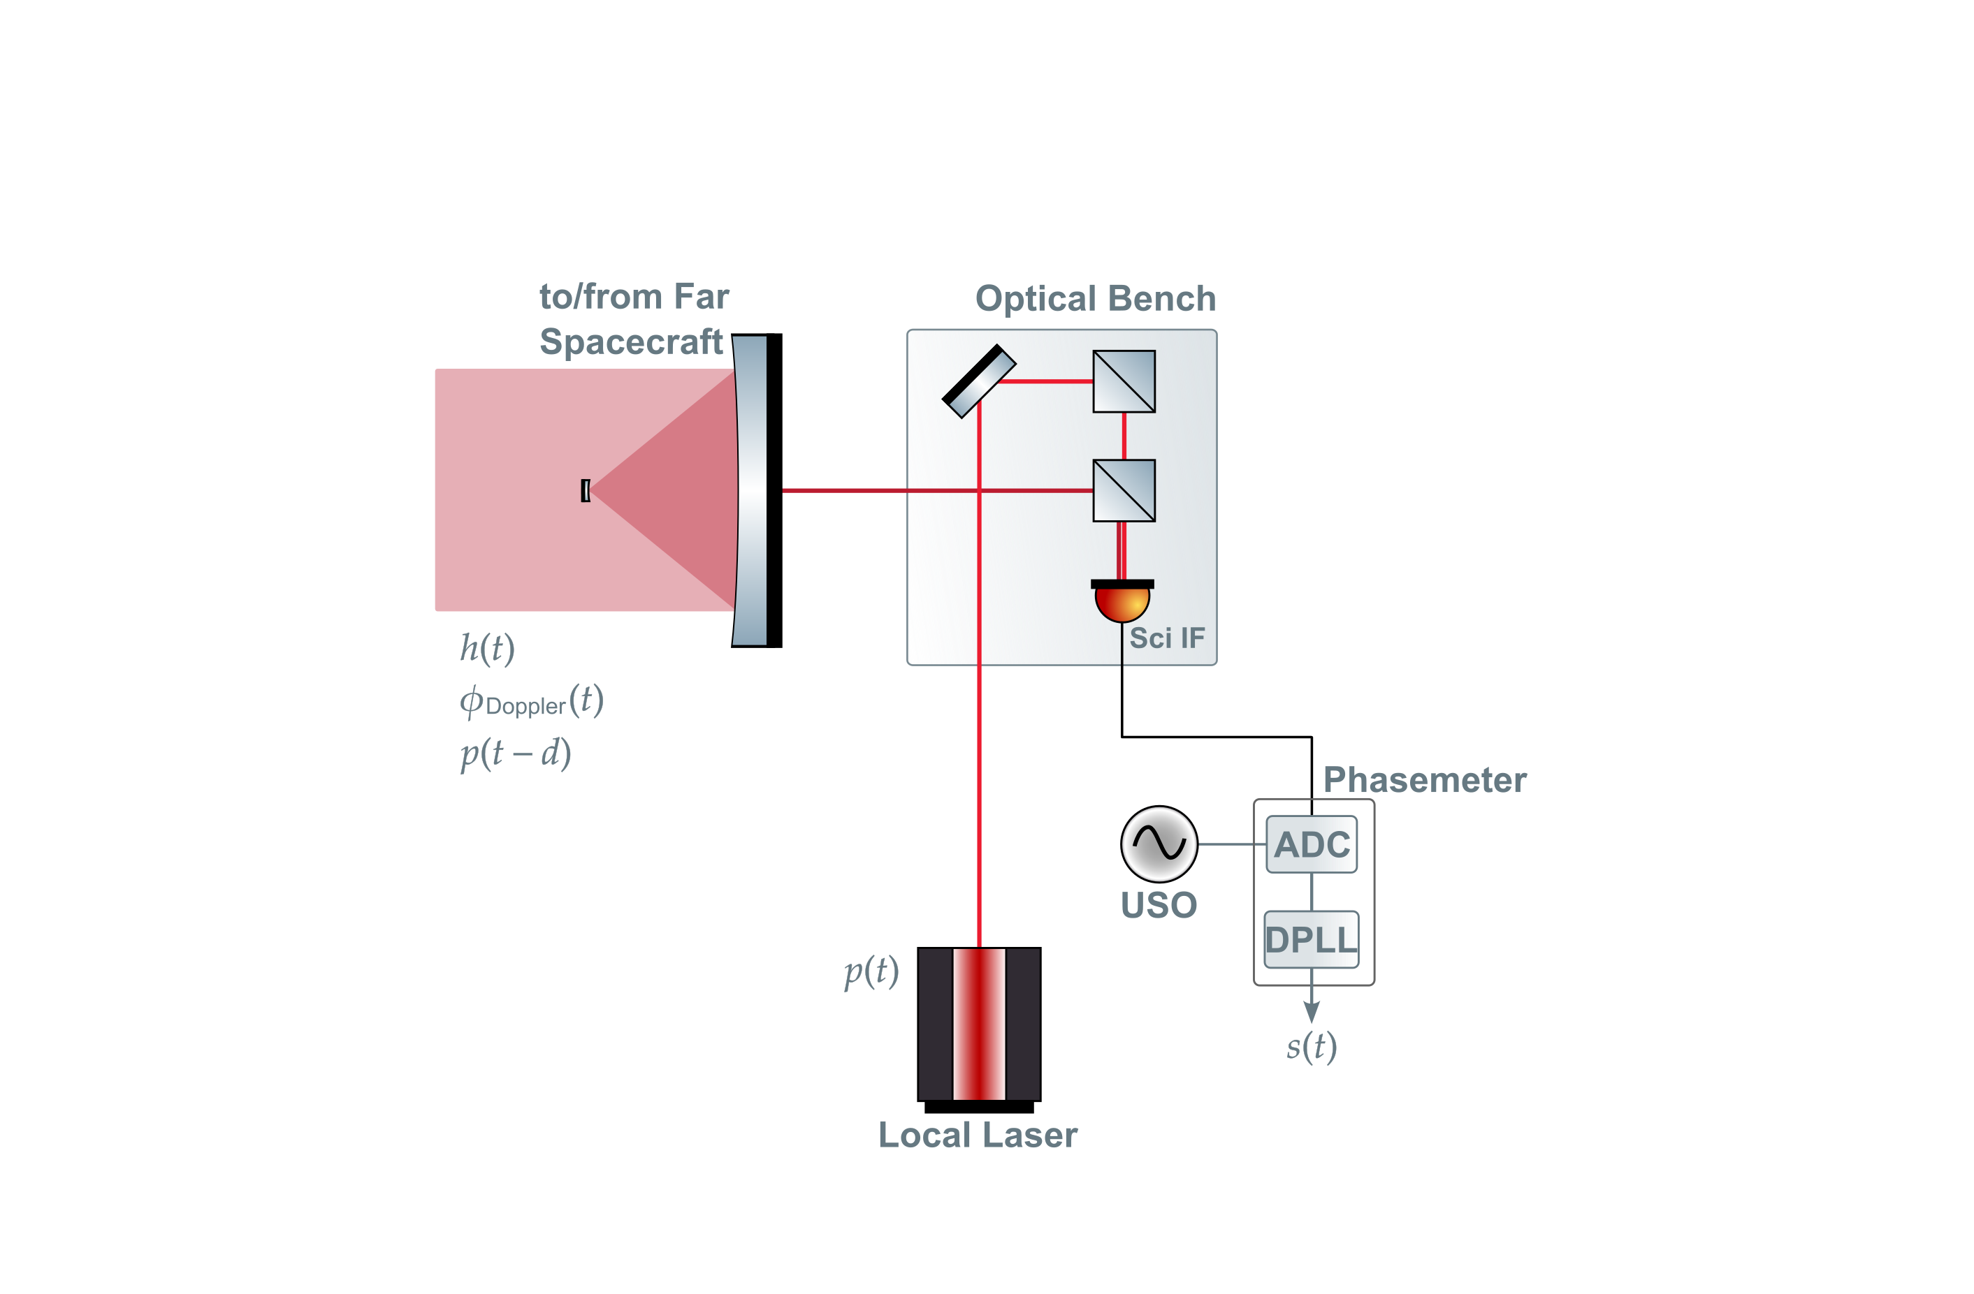
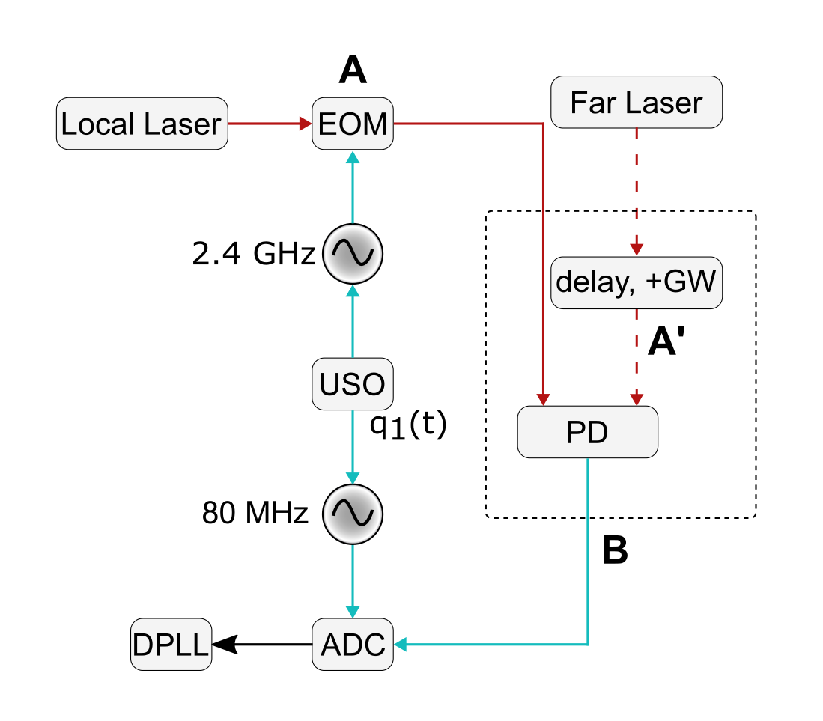
LISA Scienece Interferometer

Slide 43
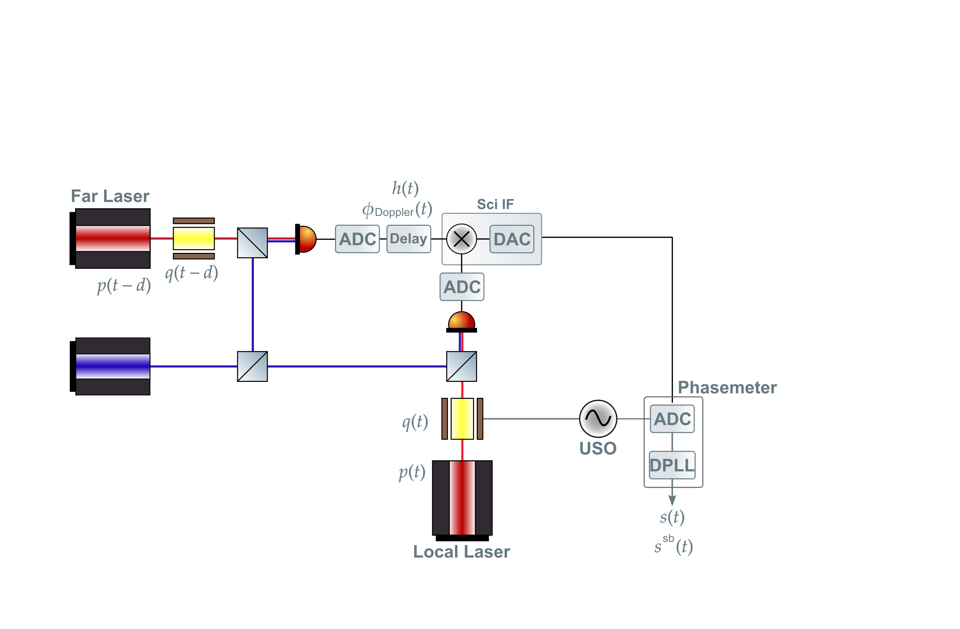

MiniLISA

